Slide 1
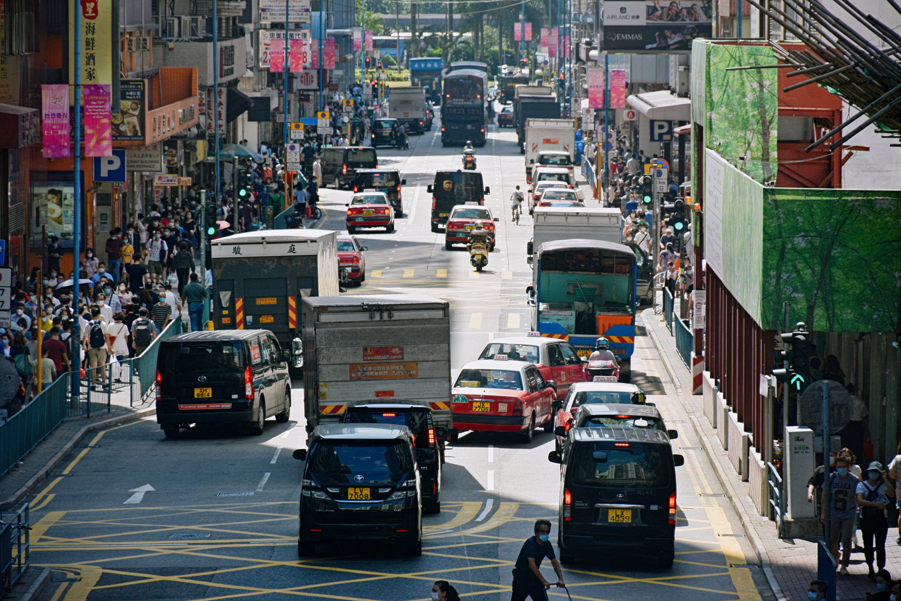

Slide 3
N

Slide 4
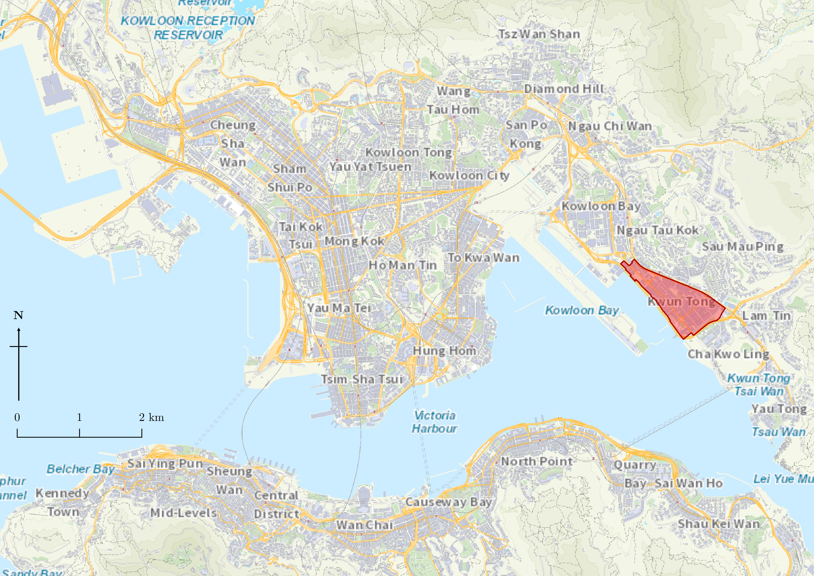
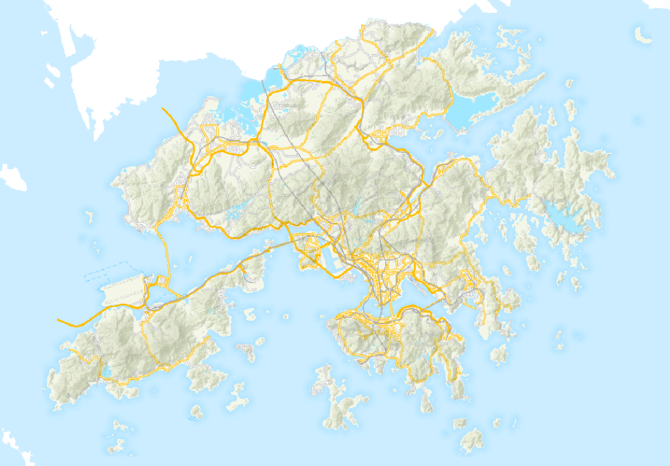
Map of HK
Located adjacent to airport
10km
Mountainous terrain and deep harbour reduces land availability
Old Kai Tak Airport
Legend
Study Area
Roads
Buildings
Sea
Terrain

Slide 5
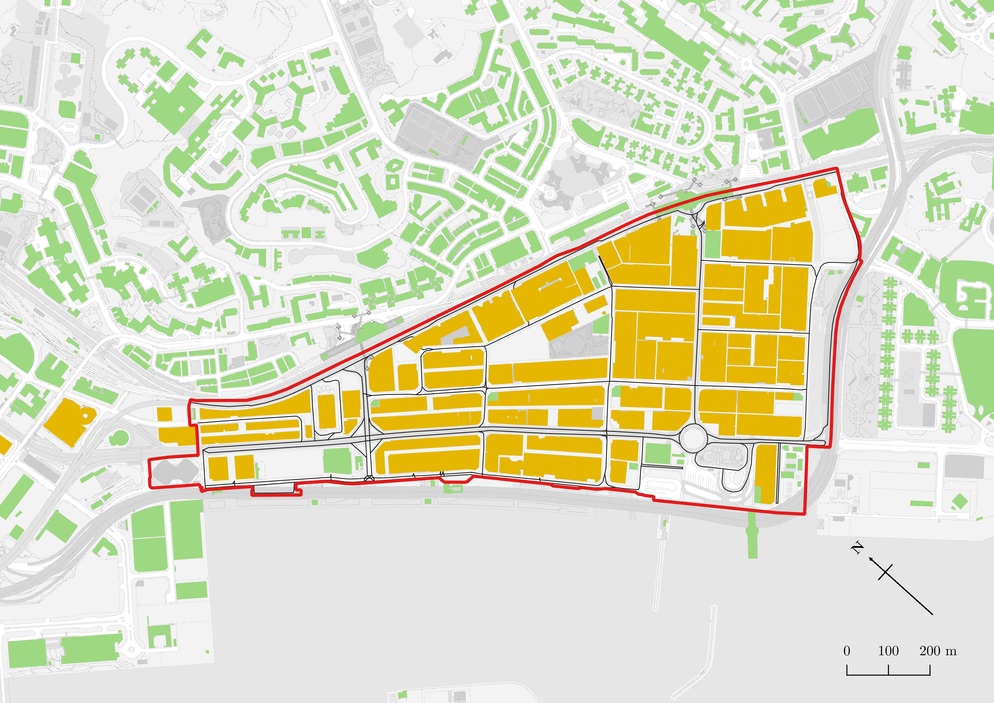
Legend
Study Area
high volume of commuters from residential districts travel into KT
Only one major road supporting entire industrial district
Industrial Land Use
Other Land Uses
Roads
Traditional gridded road infrastructure

Slide 6
Obtain iB1000 map from Lands Department
Extract list of off-street parking facilities from HKeMobility website
Extract street centrelines
Extract all buildings within study area
5.4
Construct directed node graph
Estimate gross floor area with building height and area
Estimate number of parking spaces using gross floor area of the building
5.1
5.2
Select strategic survey points
Generate sample points
Generate population nodes
Prepare location of parking spaces nodes
5.3
Perform on-site traffic counting
5.4
Perform modified Ga2SFCA for each sample
Analyse results
Compute Spearman Rank Correlation Coefficient
Validate/invalidate hypothesis
Compute t-value

Slide 7
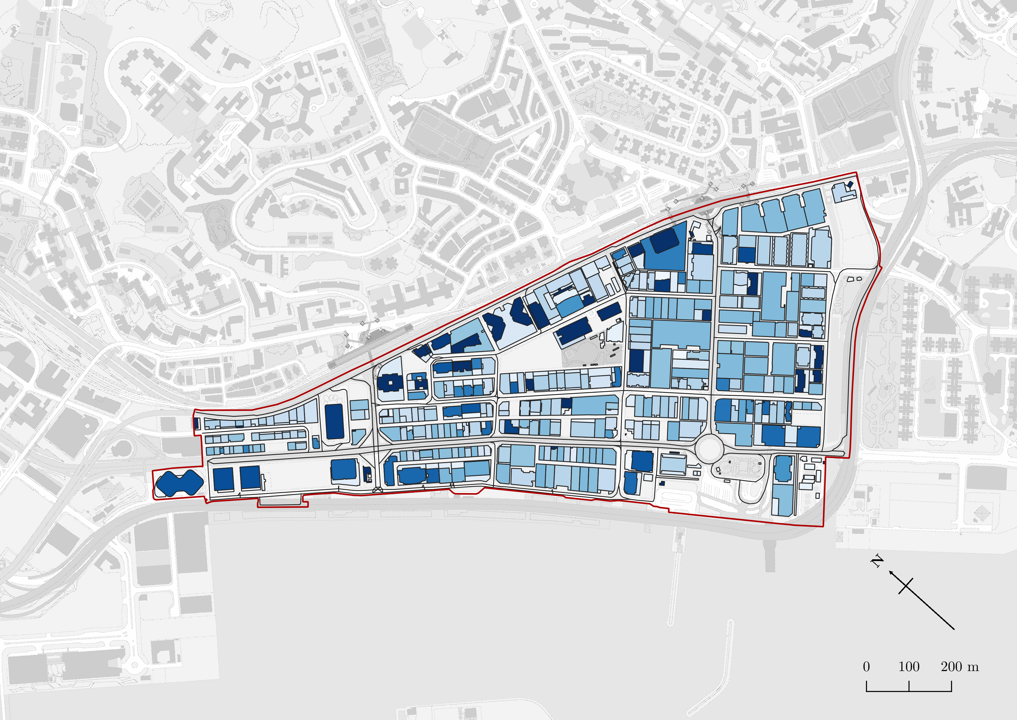
Legend
Study Area
Roads
>100 m
Building Height
0 m

Slide 8
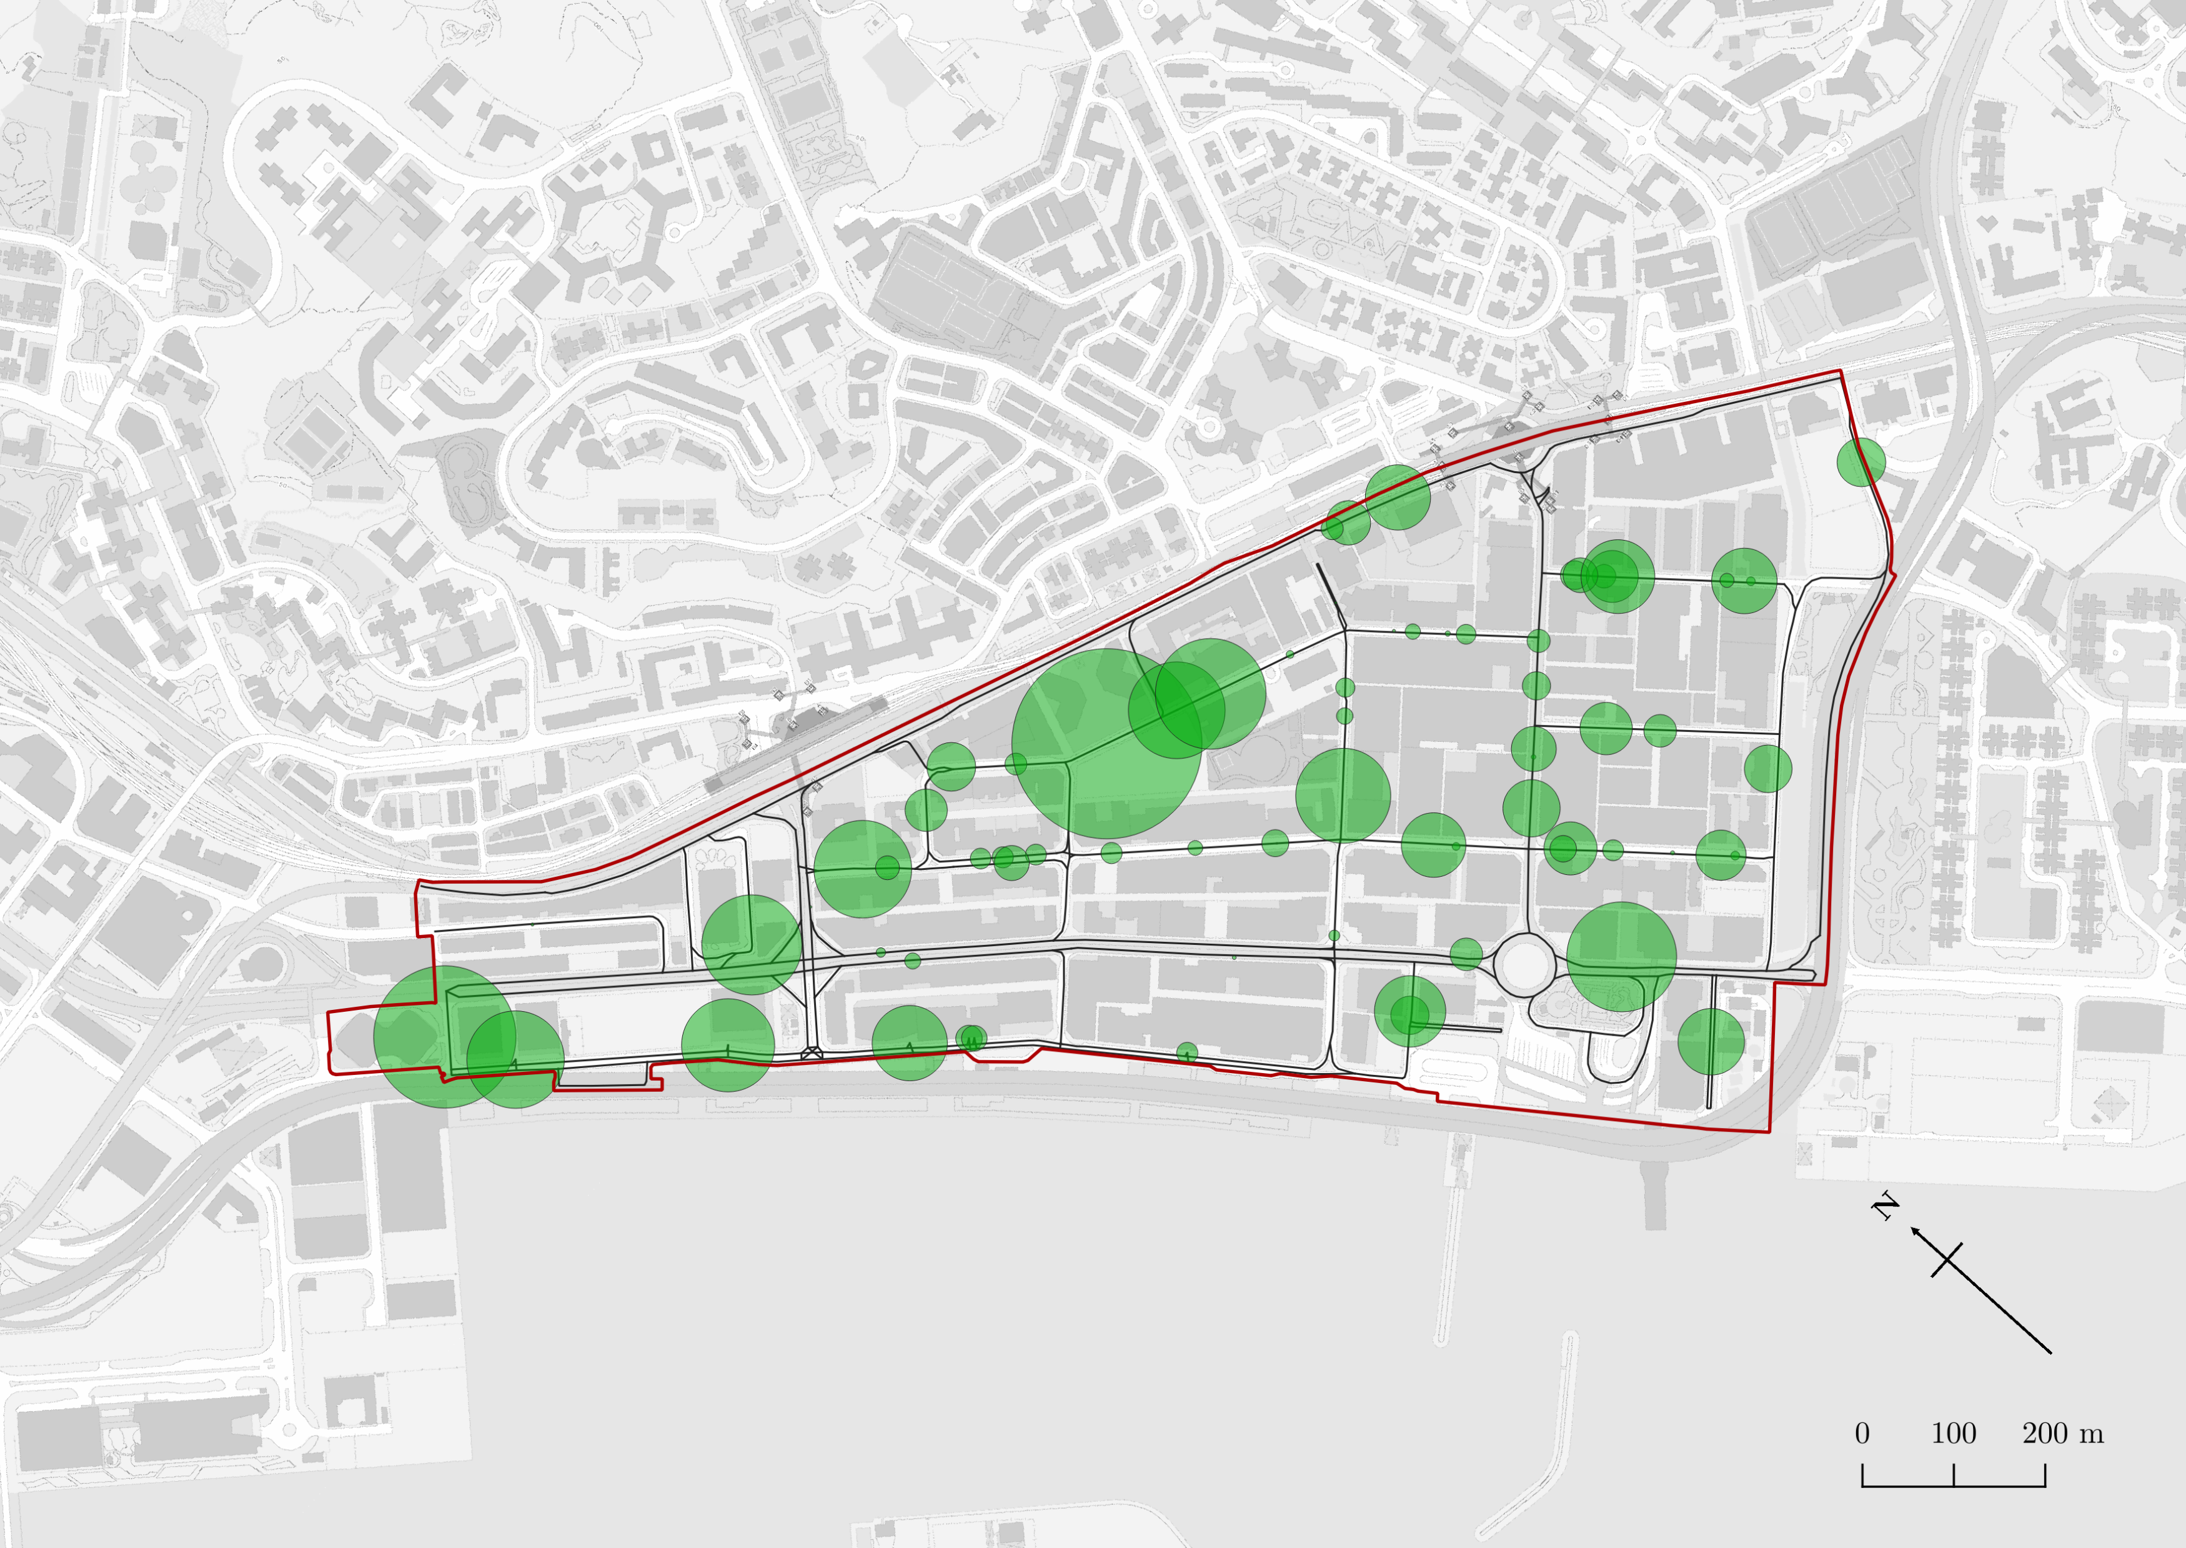
Legend
Study Area
Roads
Number of parking spaces (radius of circle corresponds to amount)
455

Slide 9
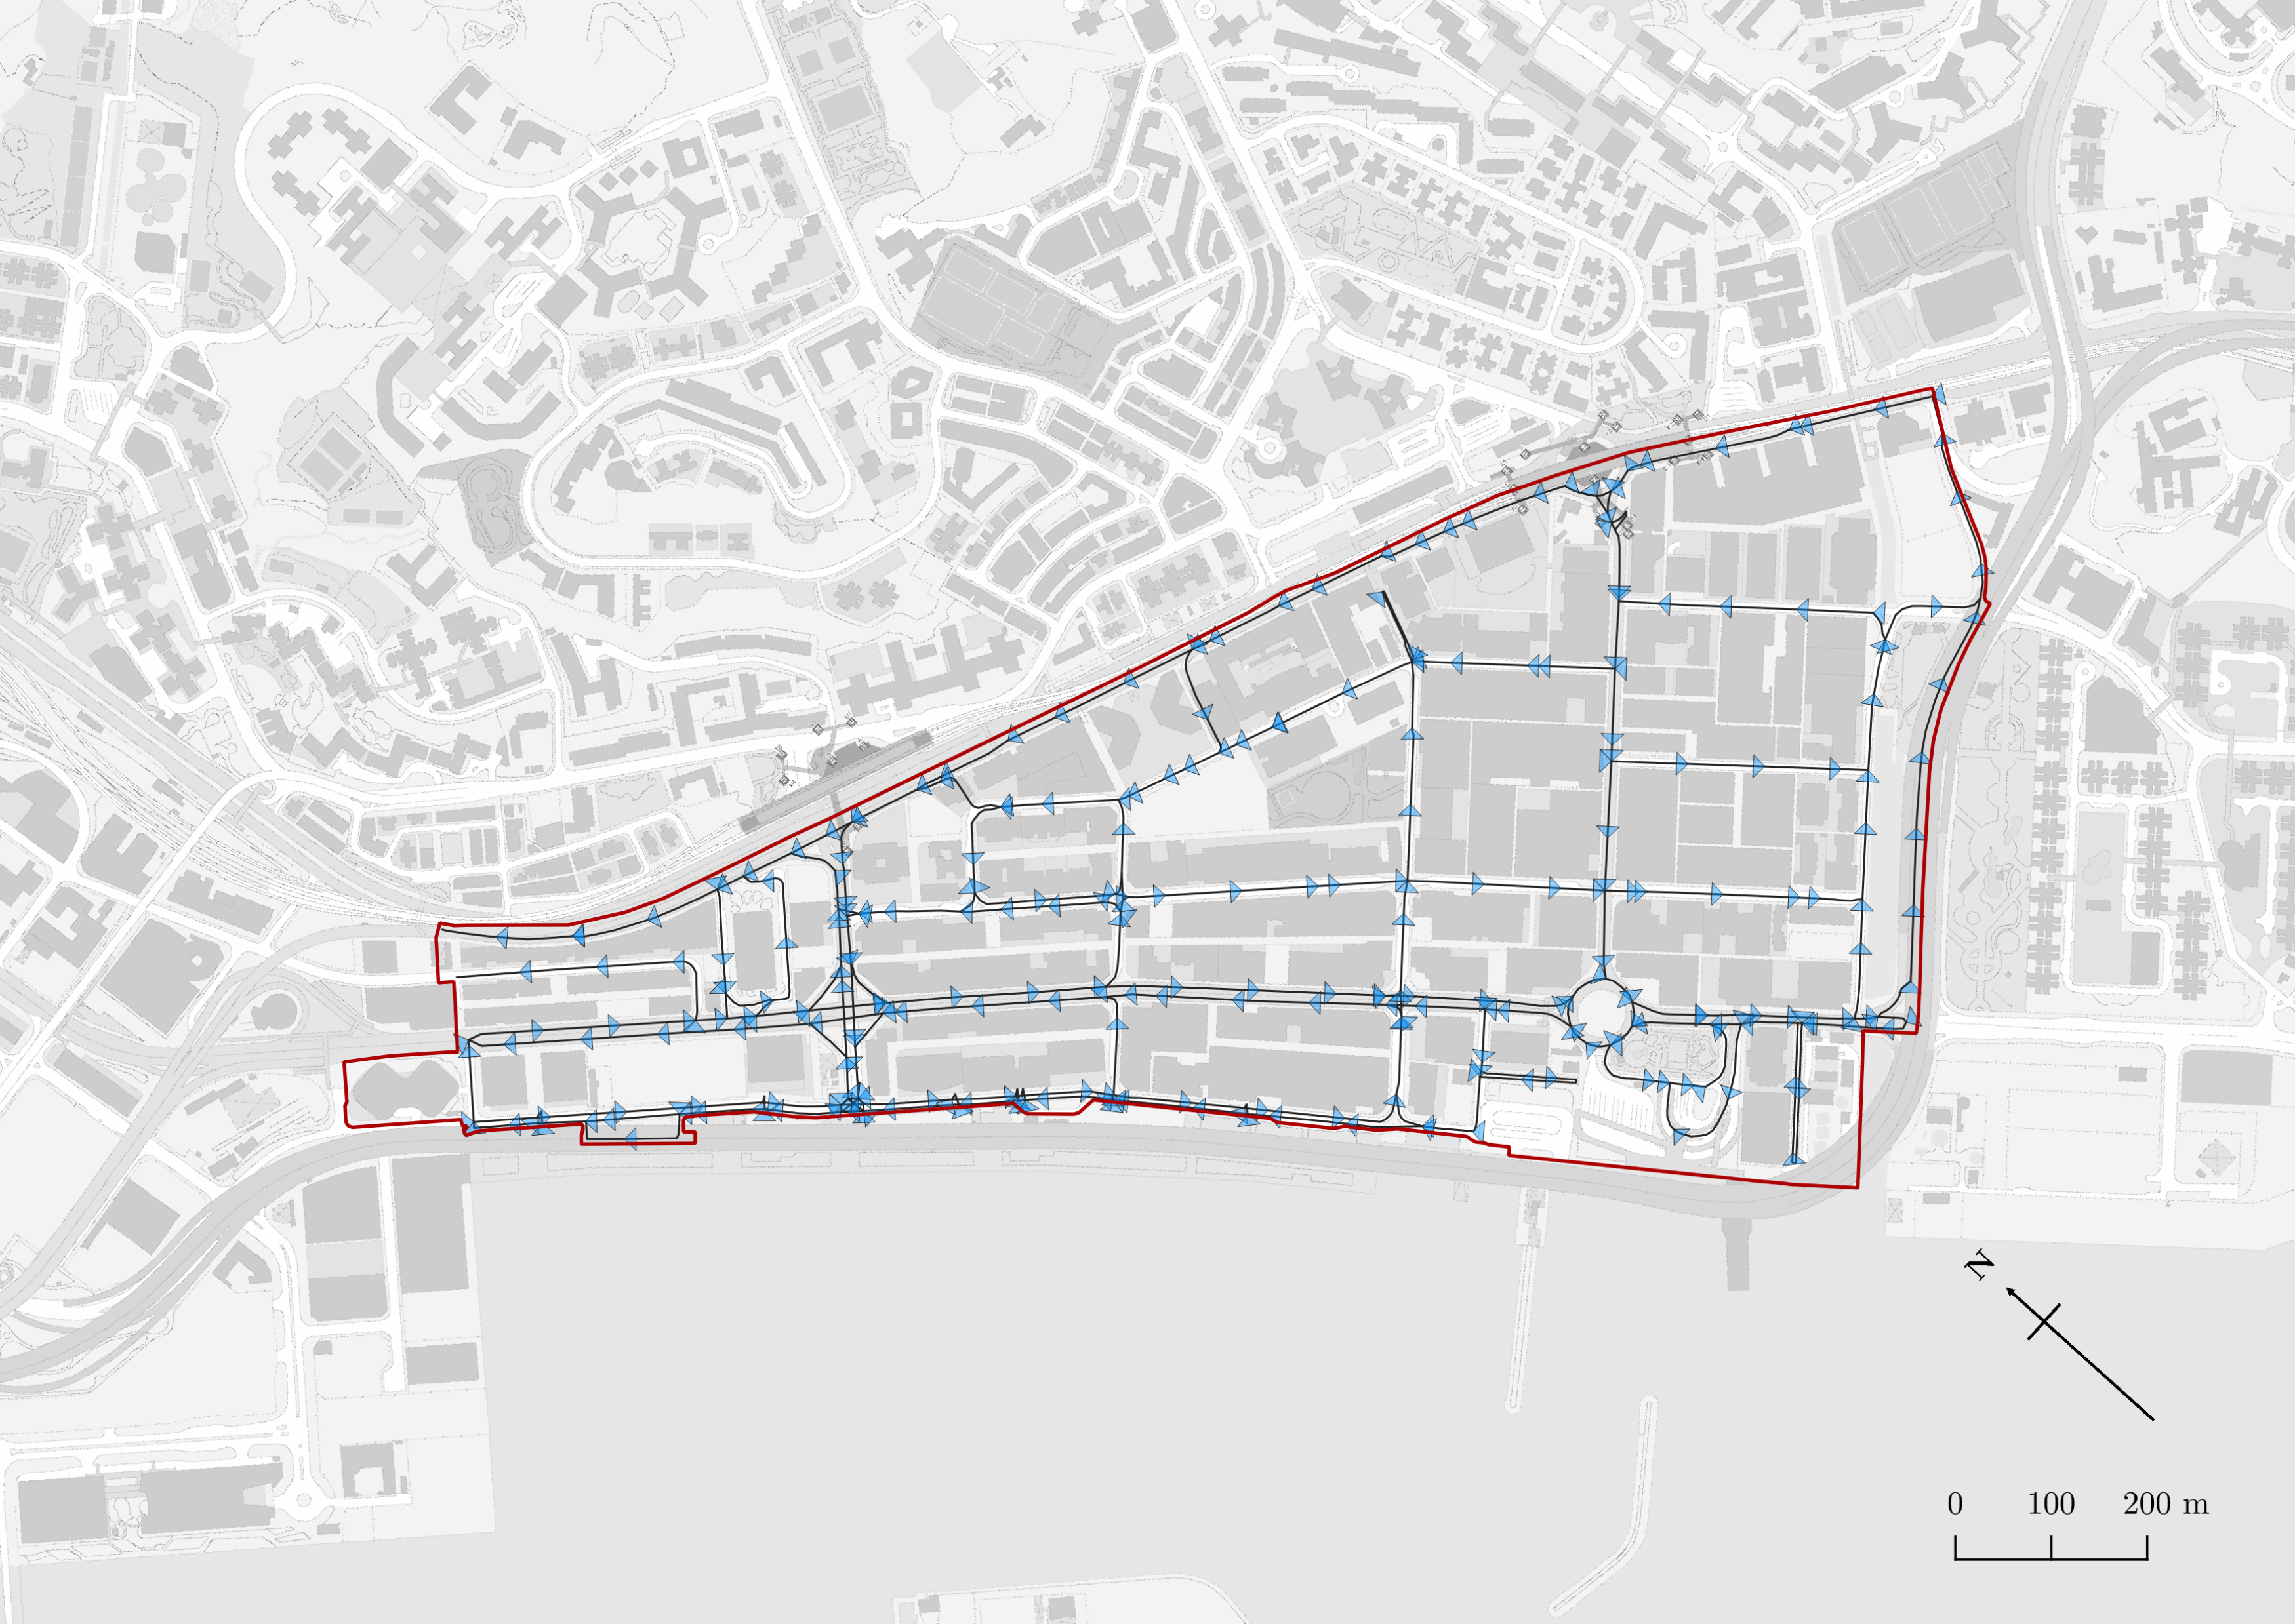
Legend
Study Area
Roads and direction
Shortest path from carpark #67 to #31
455

Slide 10
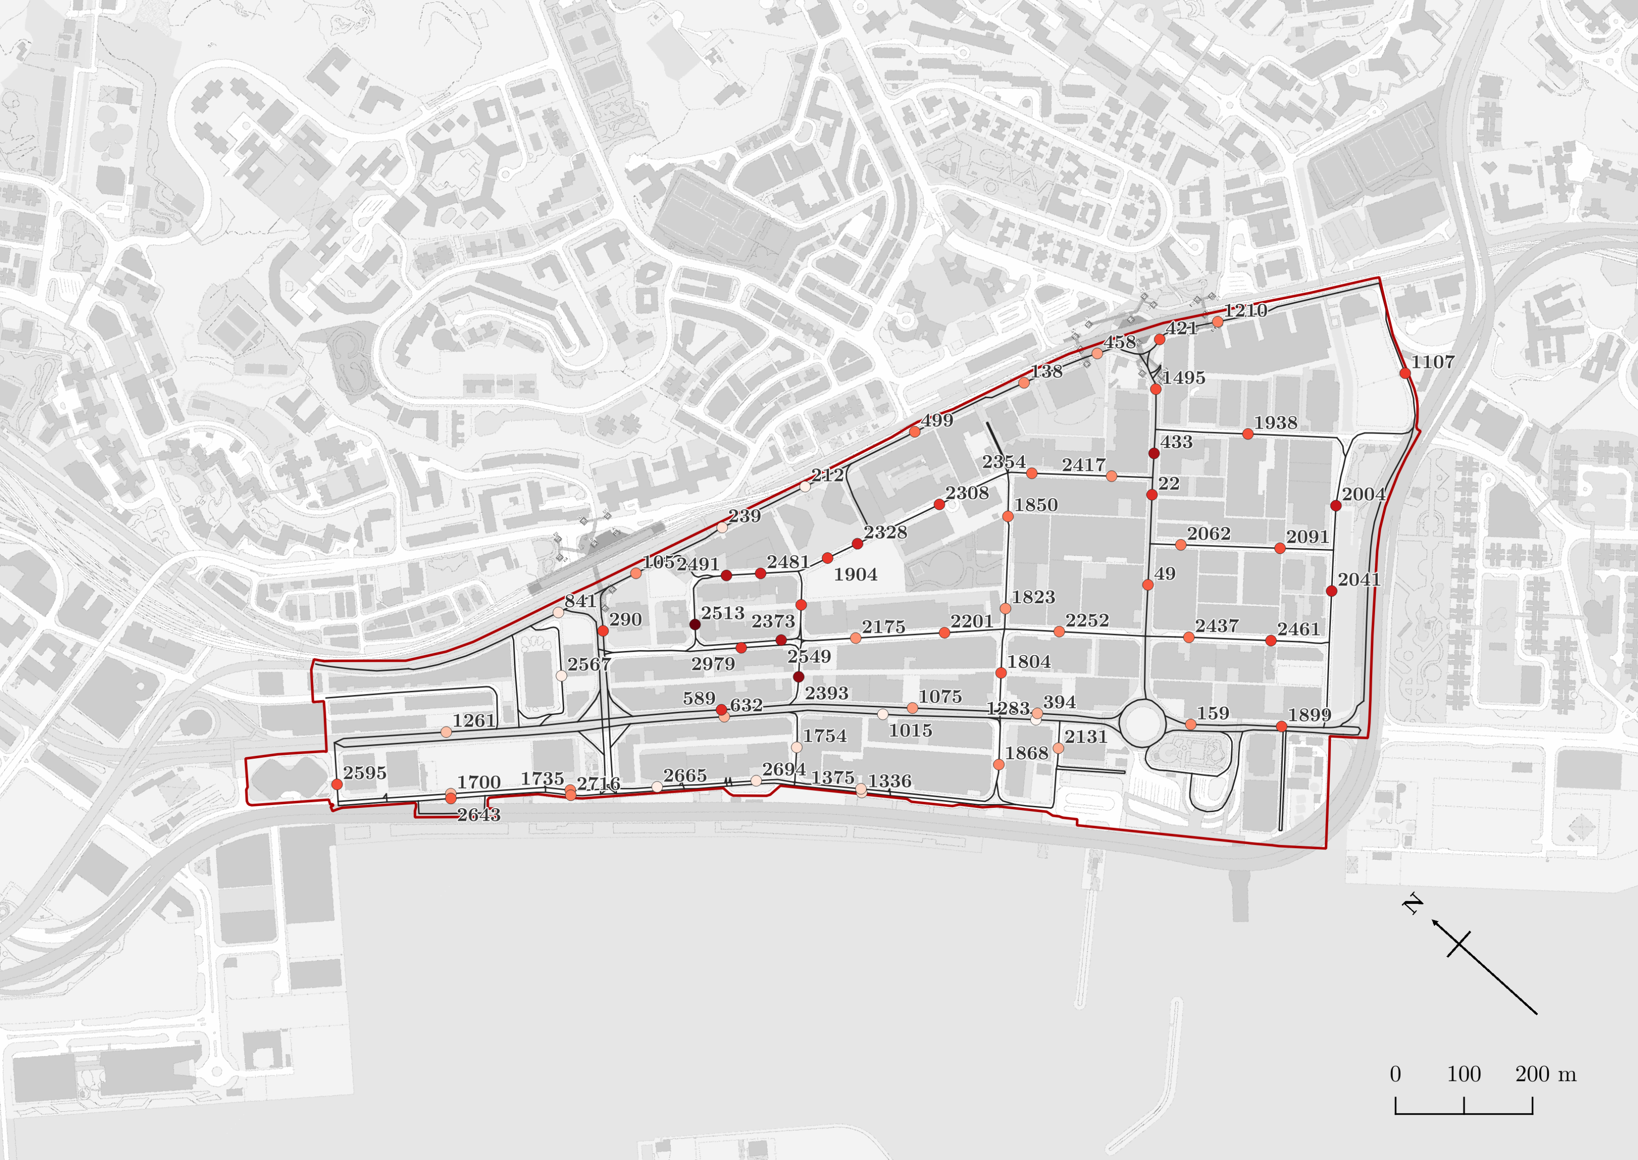
Legend
Study Area
Roads
Survey Points and their ID
0.173
Accessibility of Survey Points
0

Slide 11
State: Not occupied
State: Occupied
State: Not occupied
Car
Car
Car
Direction of motion
Direction of motion
Direction of motion
Observer’s Line of sight
Observer’s Line of sight
Observer’s Line of sight
Start time
End time
Time of which line-of-sight is occupied by the vehicle

Slide 12
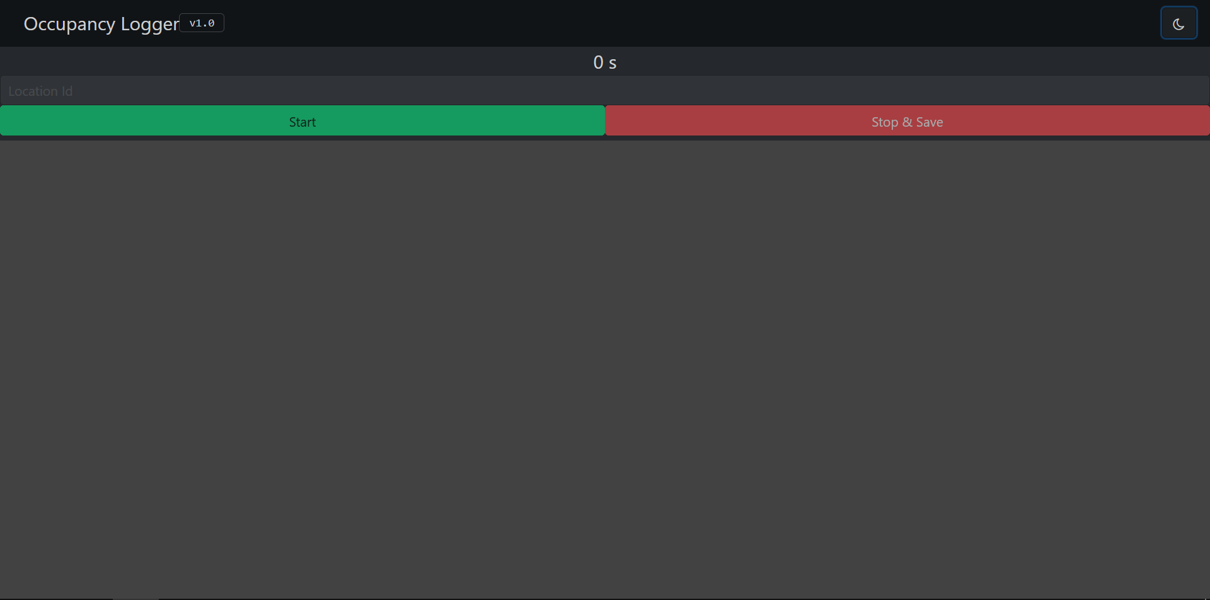
Button to start measurement
Button to stop measurement
JSON File
0.000s Not Occupied
0.688s Occupied
2.718s Not Occupied
3.142s Occupied
9.807s Not Occupied
Large area for touch-based measurements, allowing high accuracy

Slide 13
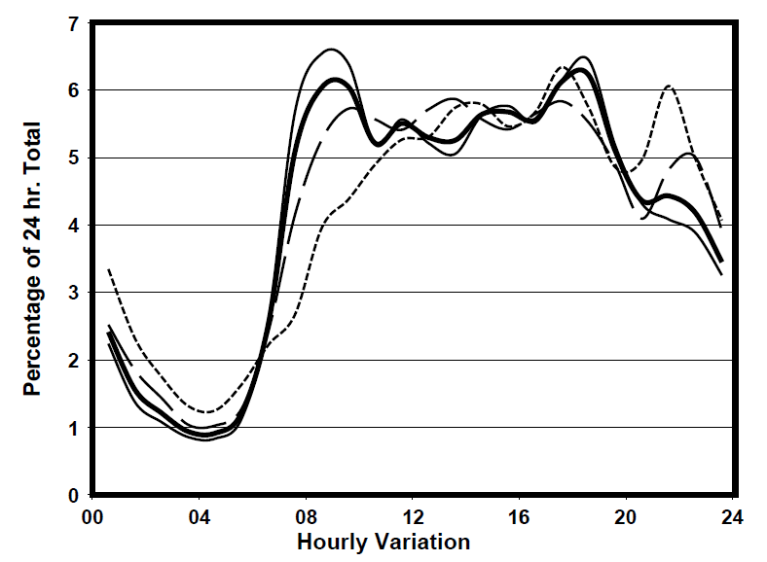

Slide 14

Rank by increasing order
If ranks are equal, take the average
Accessibility, x
Rank of x, r(x)
Relative speed, y
Rank of y, r(y)
Difference, d
d ²
0.001698
0
5487
5
-5
25
0.003340
1
4380
3,4 3.5
-2.5
6.25
0.008747
2
4380
3,4 3.5
-1.5
2.25
0.016384
3
1252
2
1
1
0.019683
4
343
1
3
9
Sum, Σd ²
43.5
Perfect negative correlation
$−$1
R
1
Perfect positive correlation

Slide 15
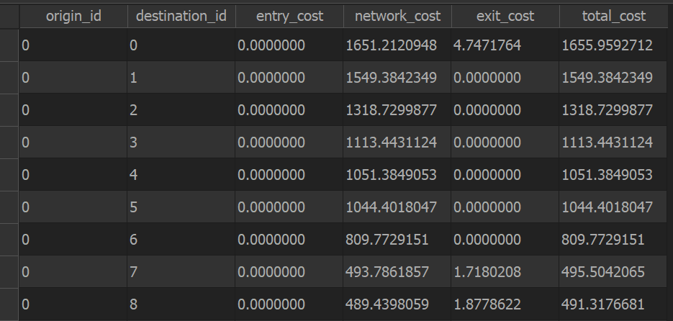
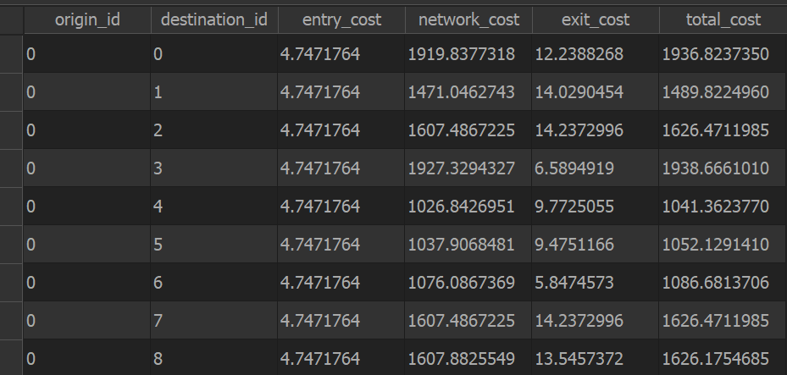
Construct directed node graphs
Create origin-destination matrices between

Slide 16
Parking facility A
Parking facility B
200
200
Consumers generally prefer facilities with greater availability of services
100
100
Movement of vehicles
Supply
Demand
Supply
Demand
SDR ratio: 0.5
SDR ratio: 2.0
Inadequate supply
inaccessible
Adequate supply
accessible

Slide 17
Parking Facility
Decreasing friction of distance
Increasingly likely to use parking facility
Probability of driver using parking facility
More likely to find another closer parking facility
Service catchment distance
Driver unwilling to use facility beyond catchment distance

Slide 18
Parking Facility
Decreasing friction of distance
Population within the catchment are likely to access parking facility
Probability of population acessing parking facility
Effective demand reduced due to distance decay
Driver
Walking is slower than driving, hence lower catchment distance
Demand catchment distance
Cost required to overcome friction of distance is too large
Service catchment distance

Slide 19
Demand catchment distance
Service catchment distance
Demand catchment distance
Distance decay effect of supply
Distance decay effect of demand

Slide 20
Graph of relative speed against accessibility
Pearson’s R : -0.356
Spearman’s R : -0.288
Relative Speed
Accessibility

Slide 21
Graph of relative speed against accessibility
Envelope of speed distributions shrinks towards zero as accessibility increases
Relative Speed
Relative Speed
Large variance
Small variance
Cases of severe traffic congestion in areas with low accessibility
Accessibility to parking spaces
Accessibility to parking spaces

Slide 22
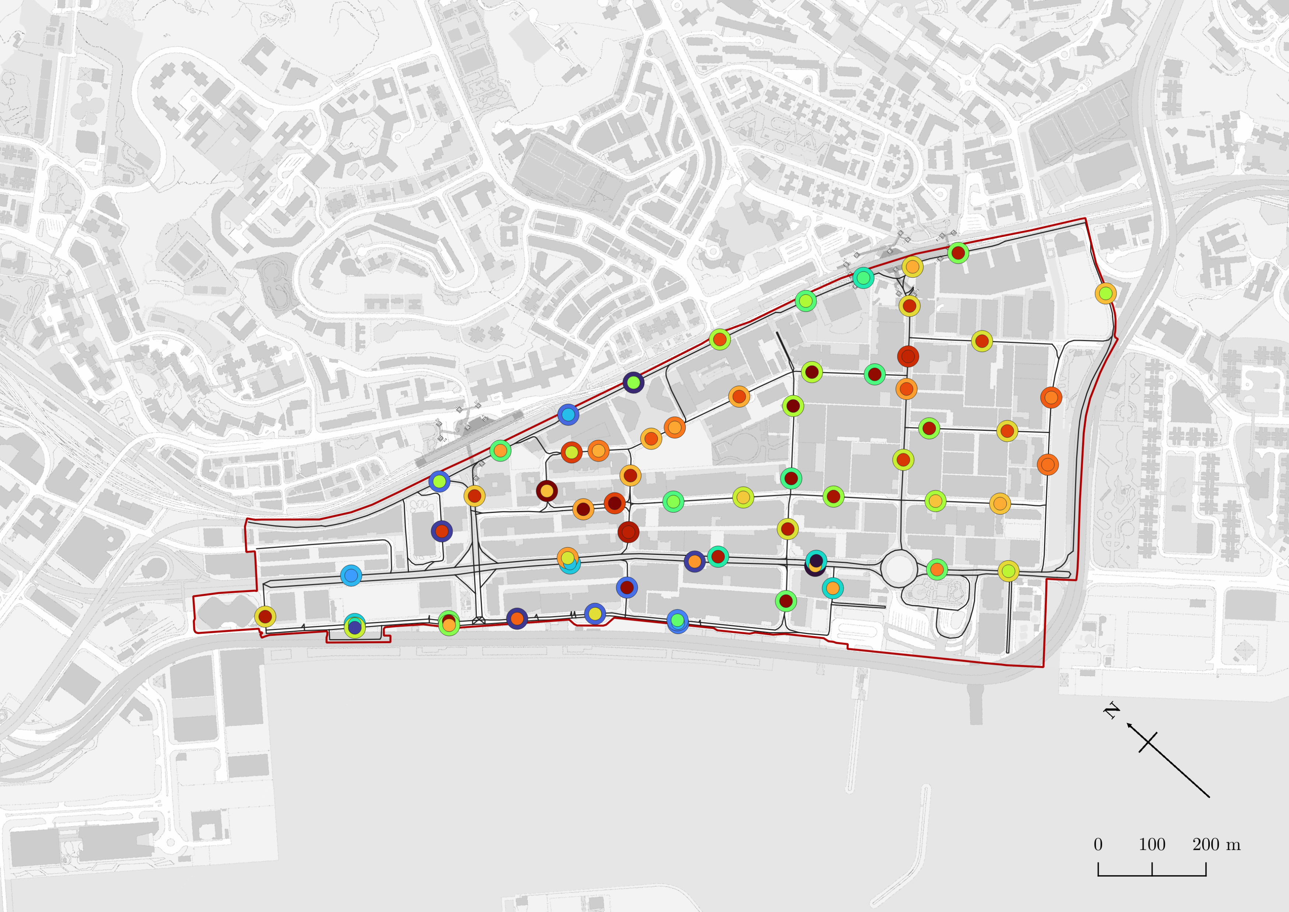
Legend
Study Area
Area 3
Roads
Area 1
Traffic speed lower than expected
Outer circle: parking accessibility
Inner circle: relative traffic speed
Colour denotes magnitude of variables
Traffic speed and accessibility closely correlated
Parking accessibility
Relative traffic speed
0
0.0736
270
10252
SHING YIP STREET
HOW MING STREET
HUNG TO ROAD
HING YIP STREET
Area 2
TSUN YIP STREET
Traffic speed and accessibility closely correlated
Area 4
Traffic speed lower than expected

Slide 23
PHYSICAL BARRICADES

Slide 24
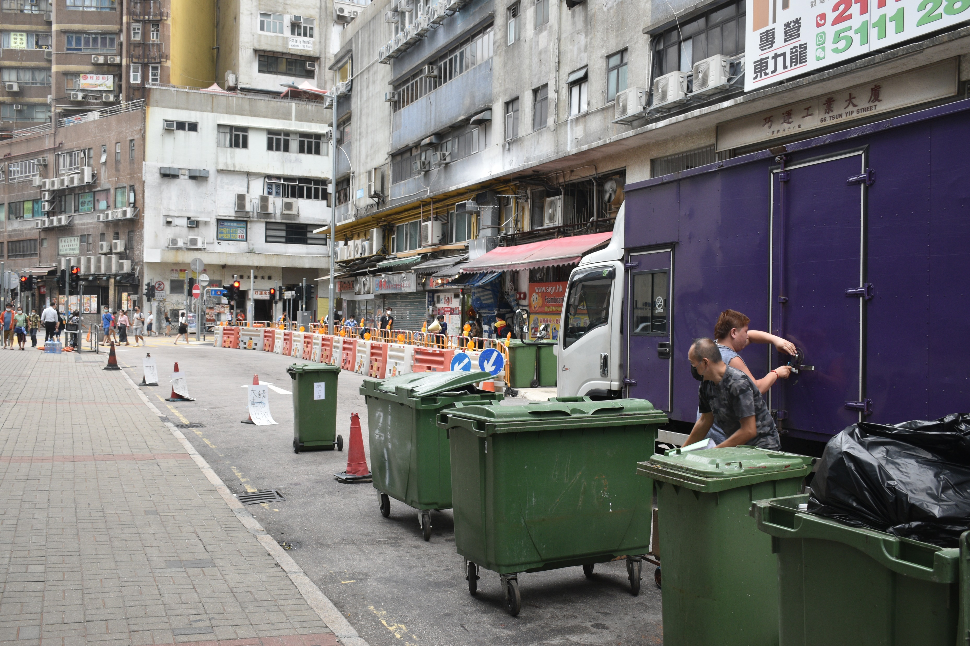
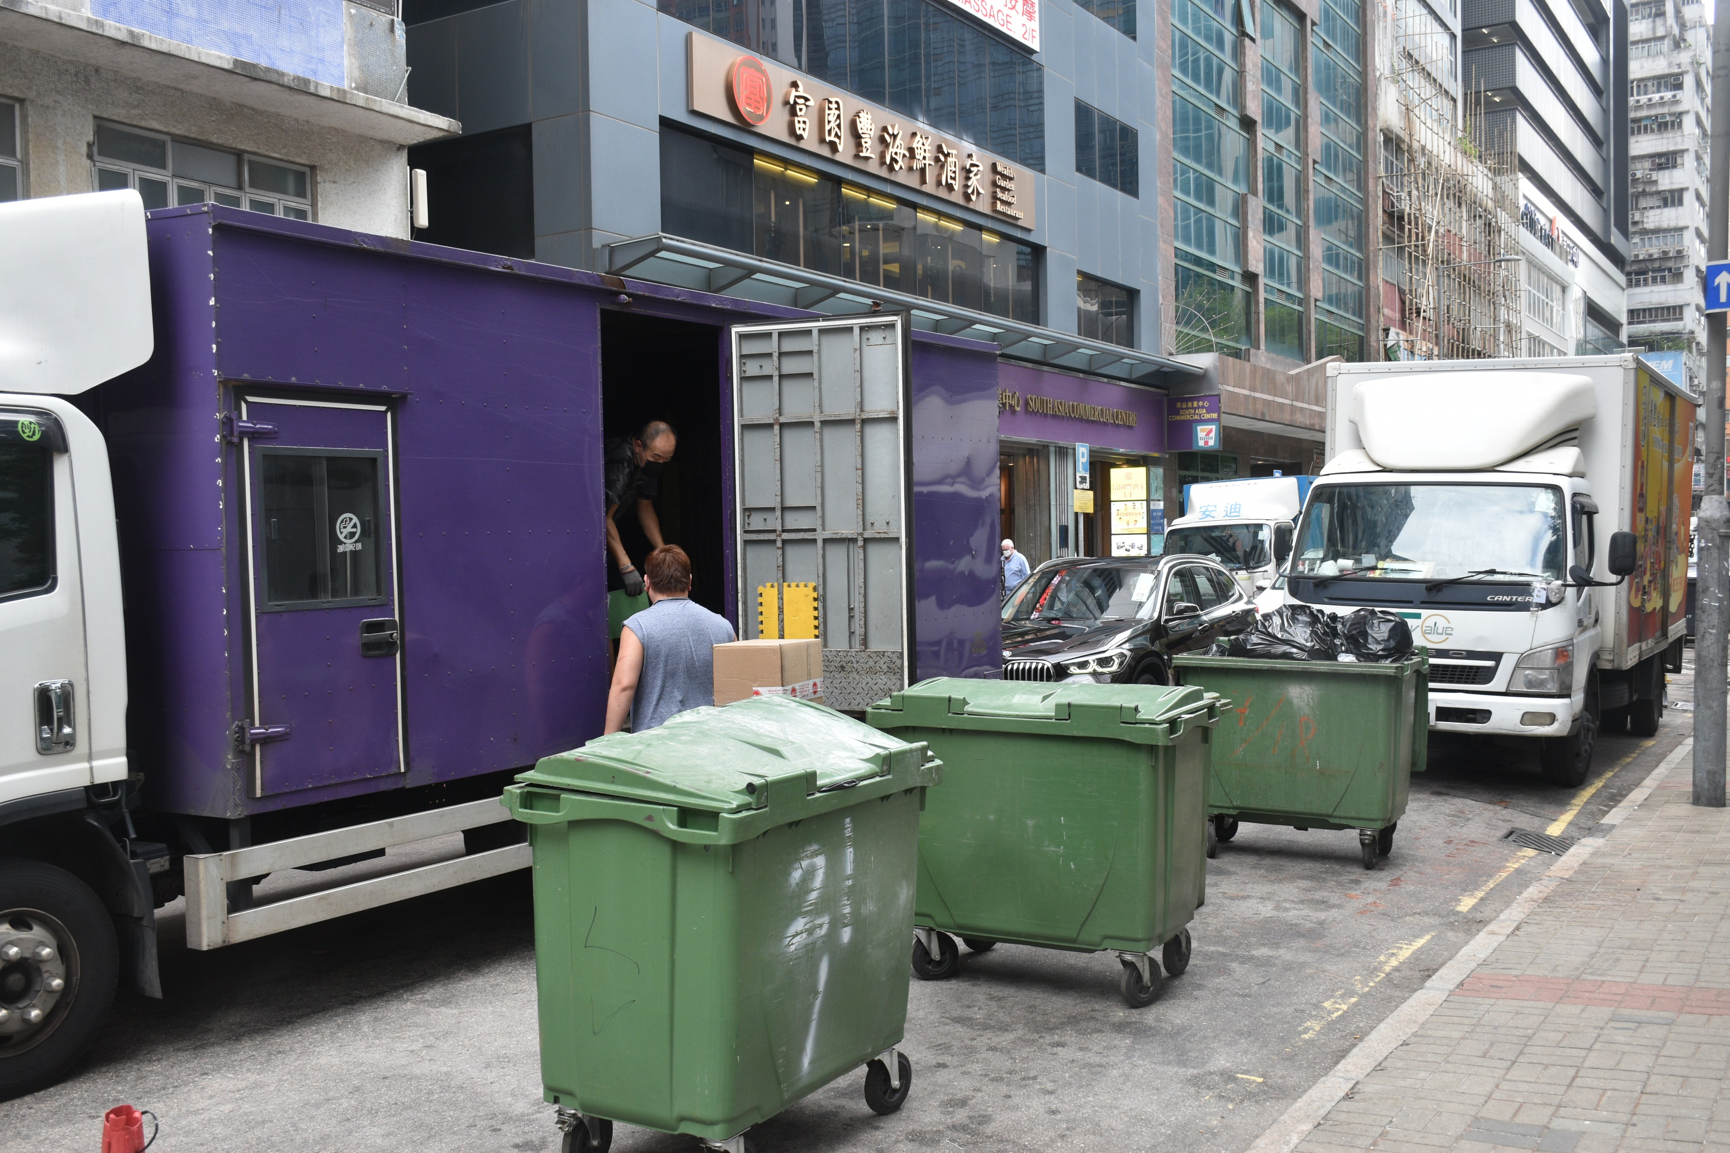
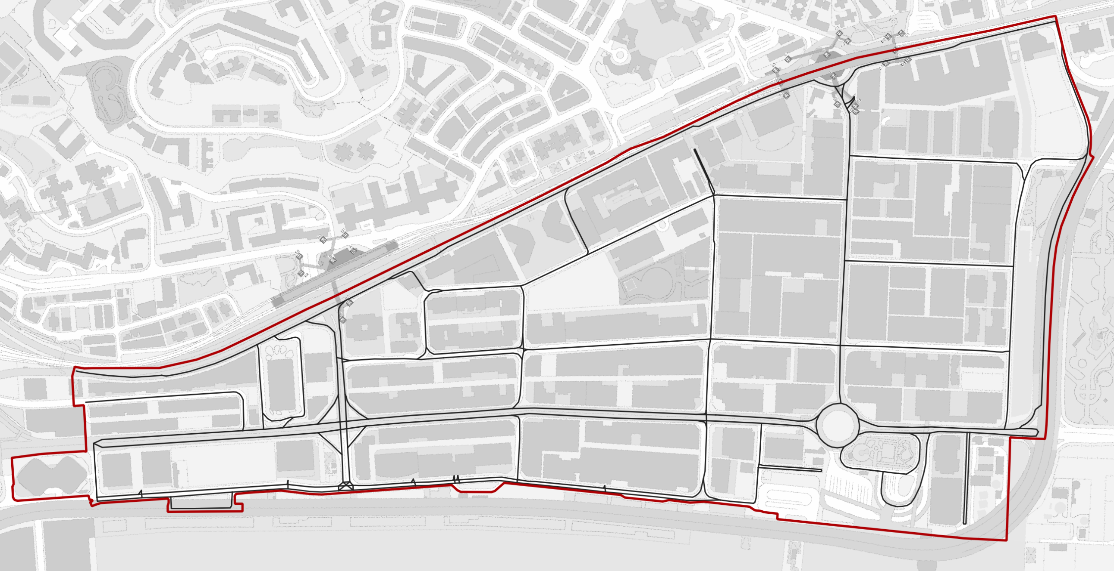
Location
Generation of long traffic queue lags behind
Truck forced to unload goods at street centre
Road capacity significantly reduced
Use of mobile barricades to reserve parking spaces
Notes:
PHSYICAL BARRICADES

Slide 25
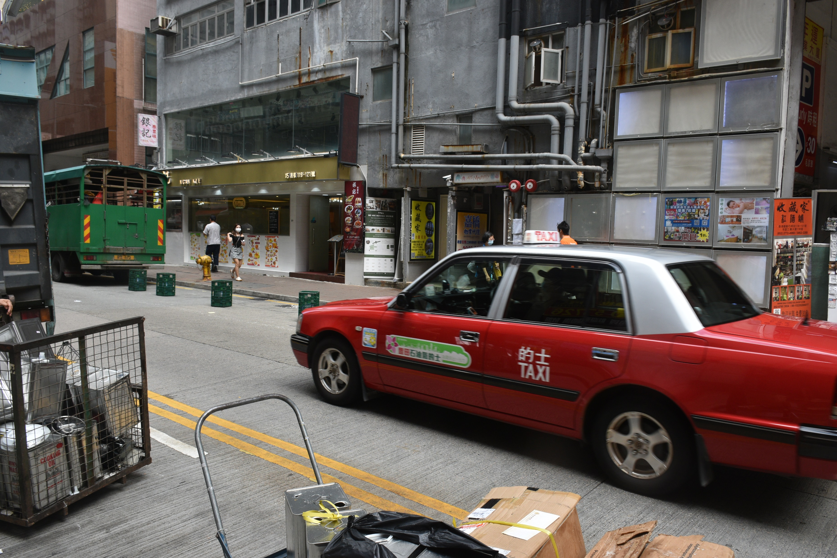
Vehicle acceleration may be sporadic when probing for parking spaces
Taxi has to find available spots for passenger alighting
Barricades used to reserve parking spaces
Road capacity significantly reduced
Location
Notes:
PHSYICAL BARRICADES

Slide 26
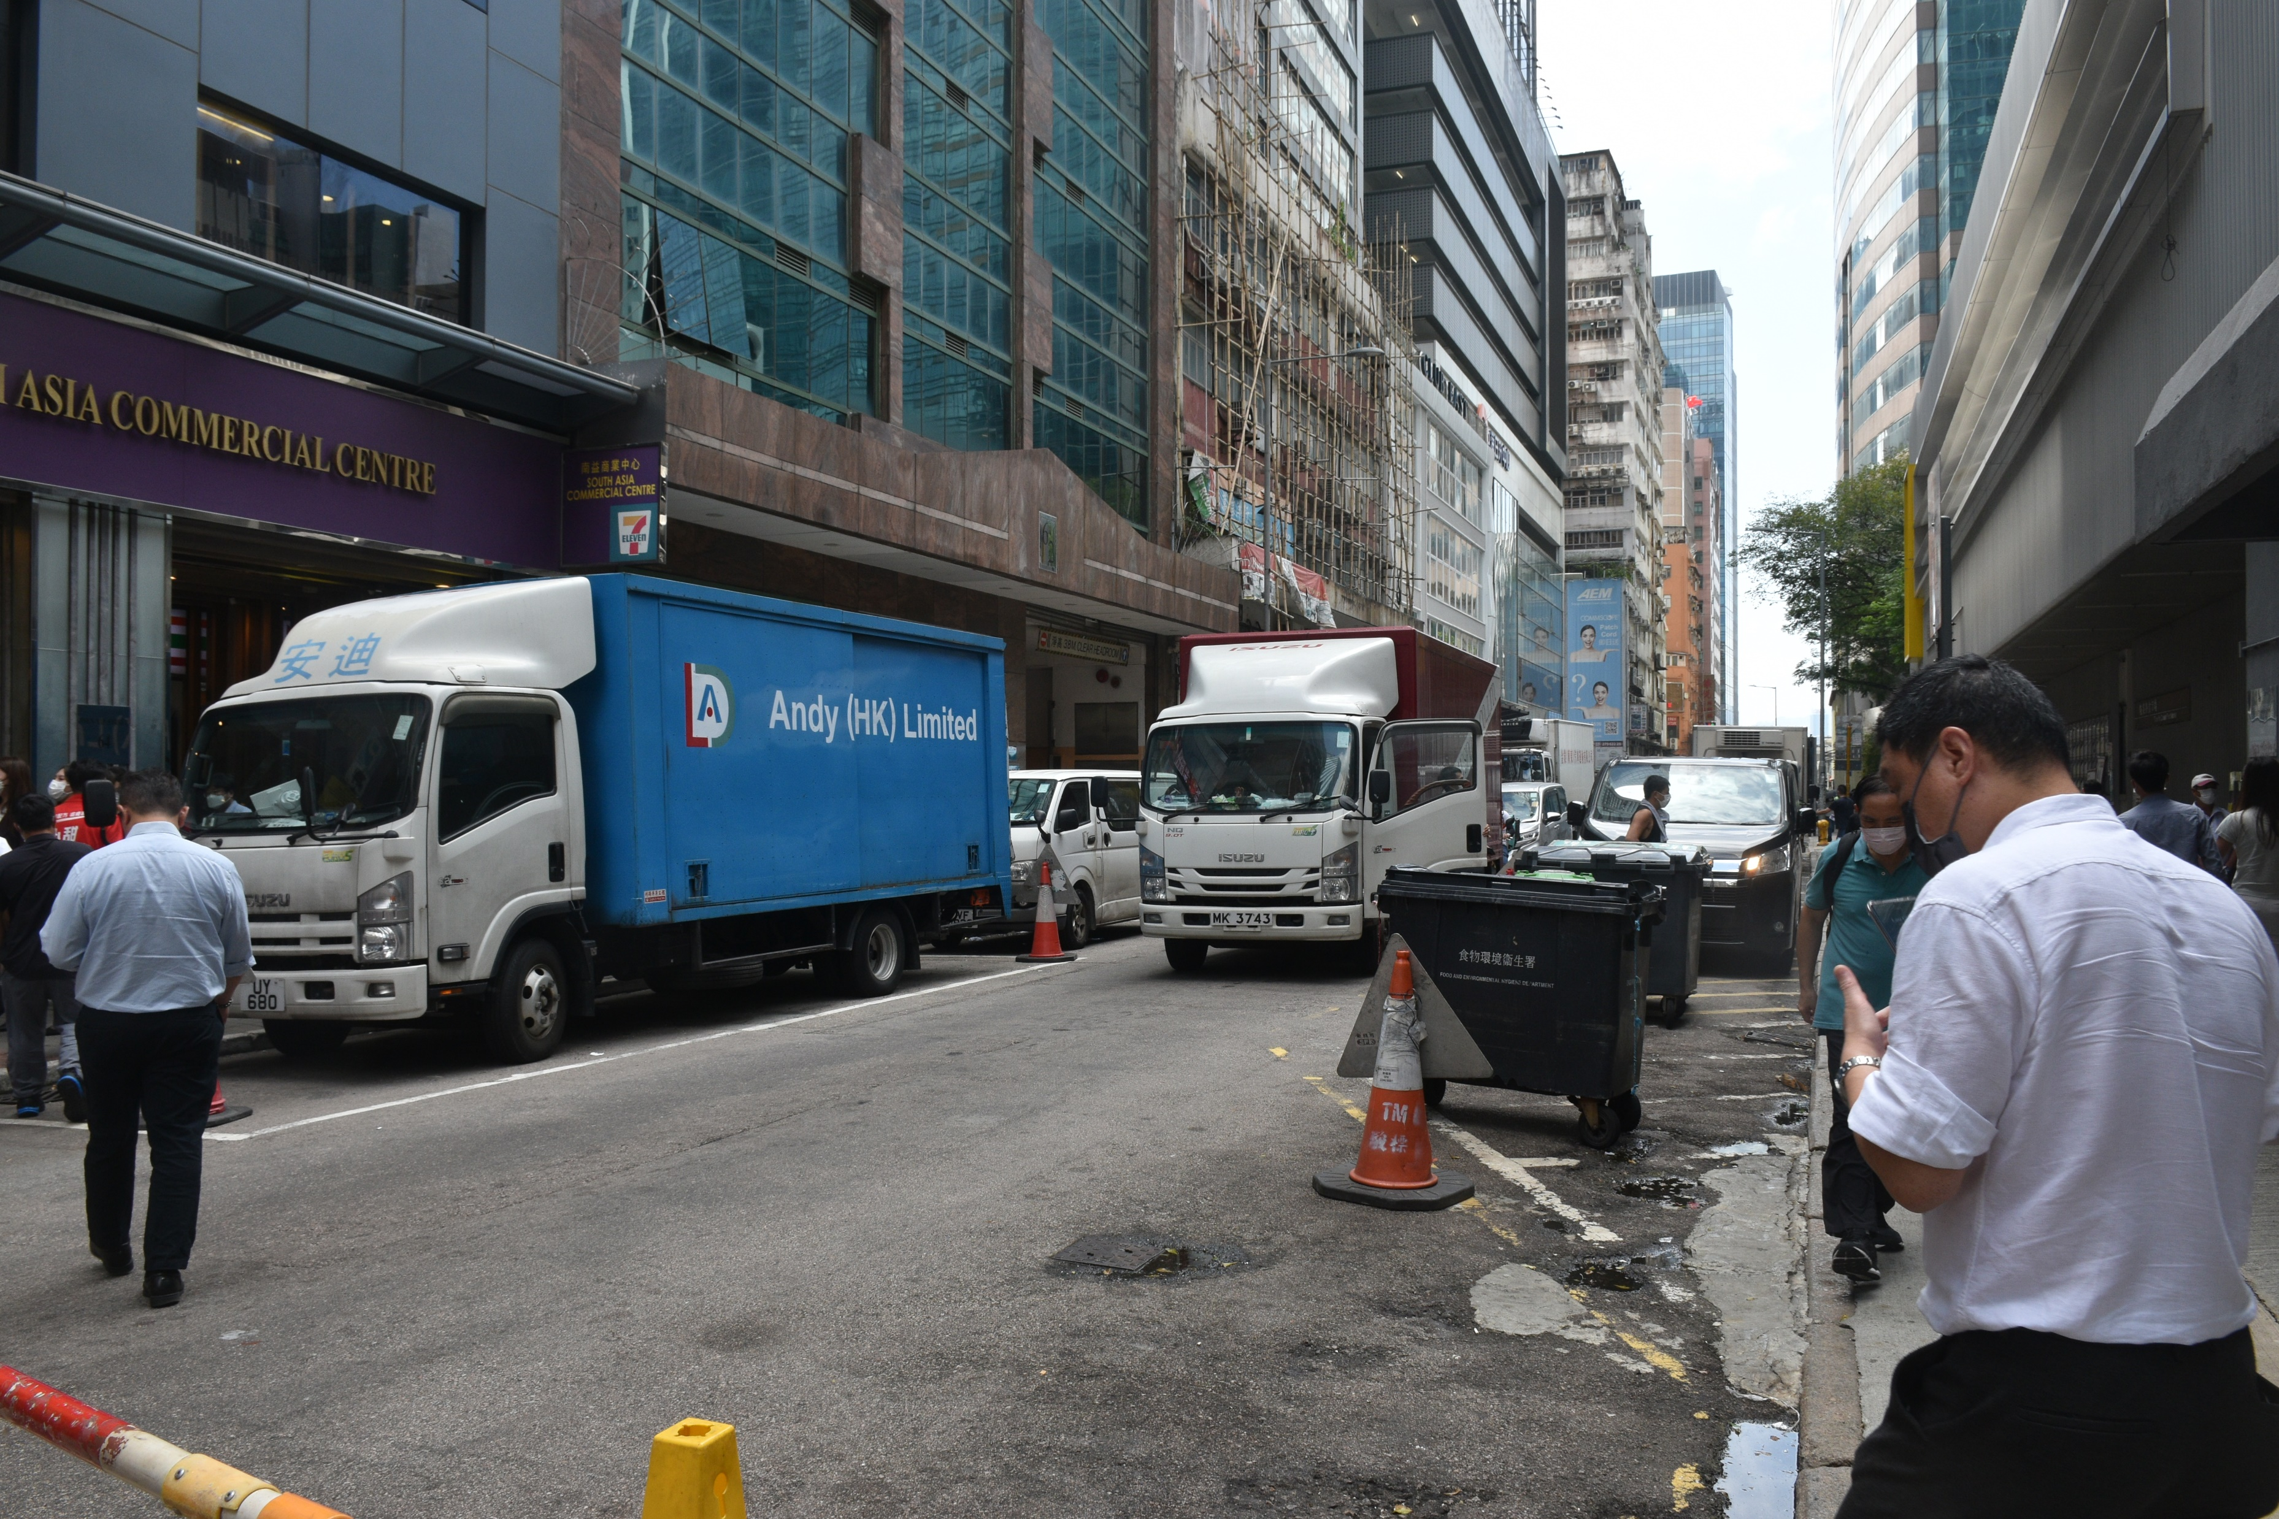
Driver forced to unload goods with immediate proximity to destination
Traffic backlog generated
Barricades prevent trucks from parking
Location
Notes:
TERRITORY WIDE PARKING SPACE INSUFFICIENCY

Slide 27
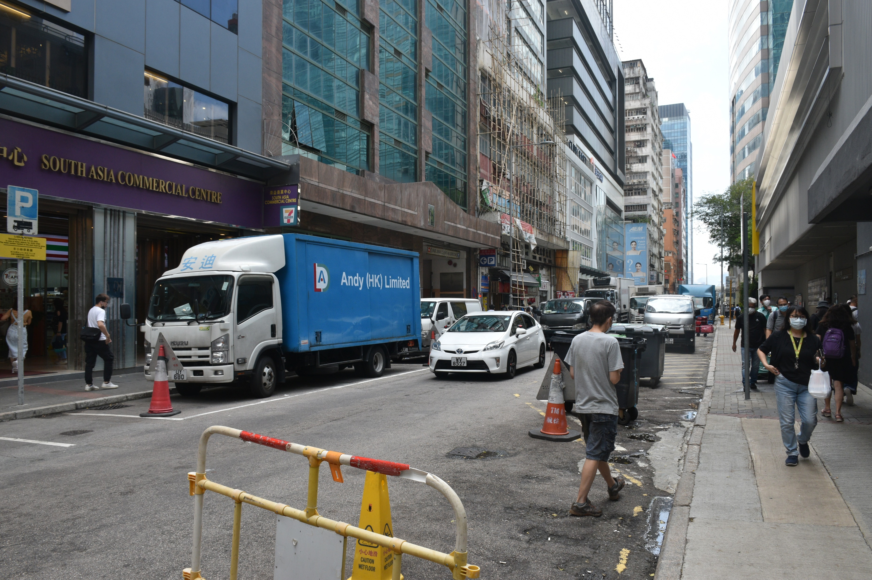

Slide 28
ILLEGAL/ DOUBLE PARKING

Slide 29
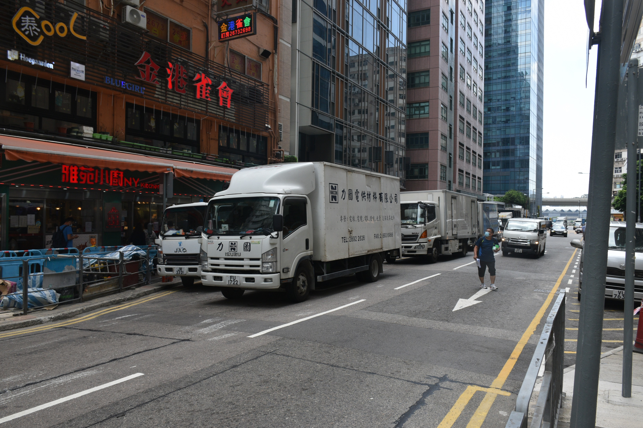
Location
Double parking occurs for multiple vehicles
Parking on yellow hatched lines are prohibited
By law, double yellow stripes prohibits vehicle stoppage

Slide 30
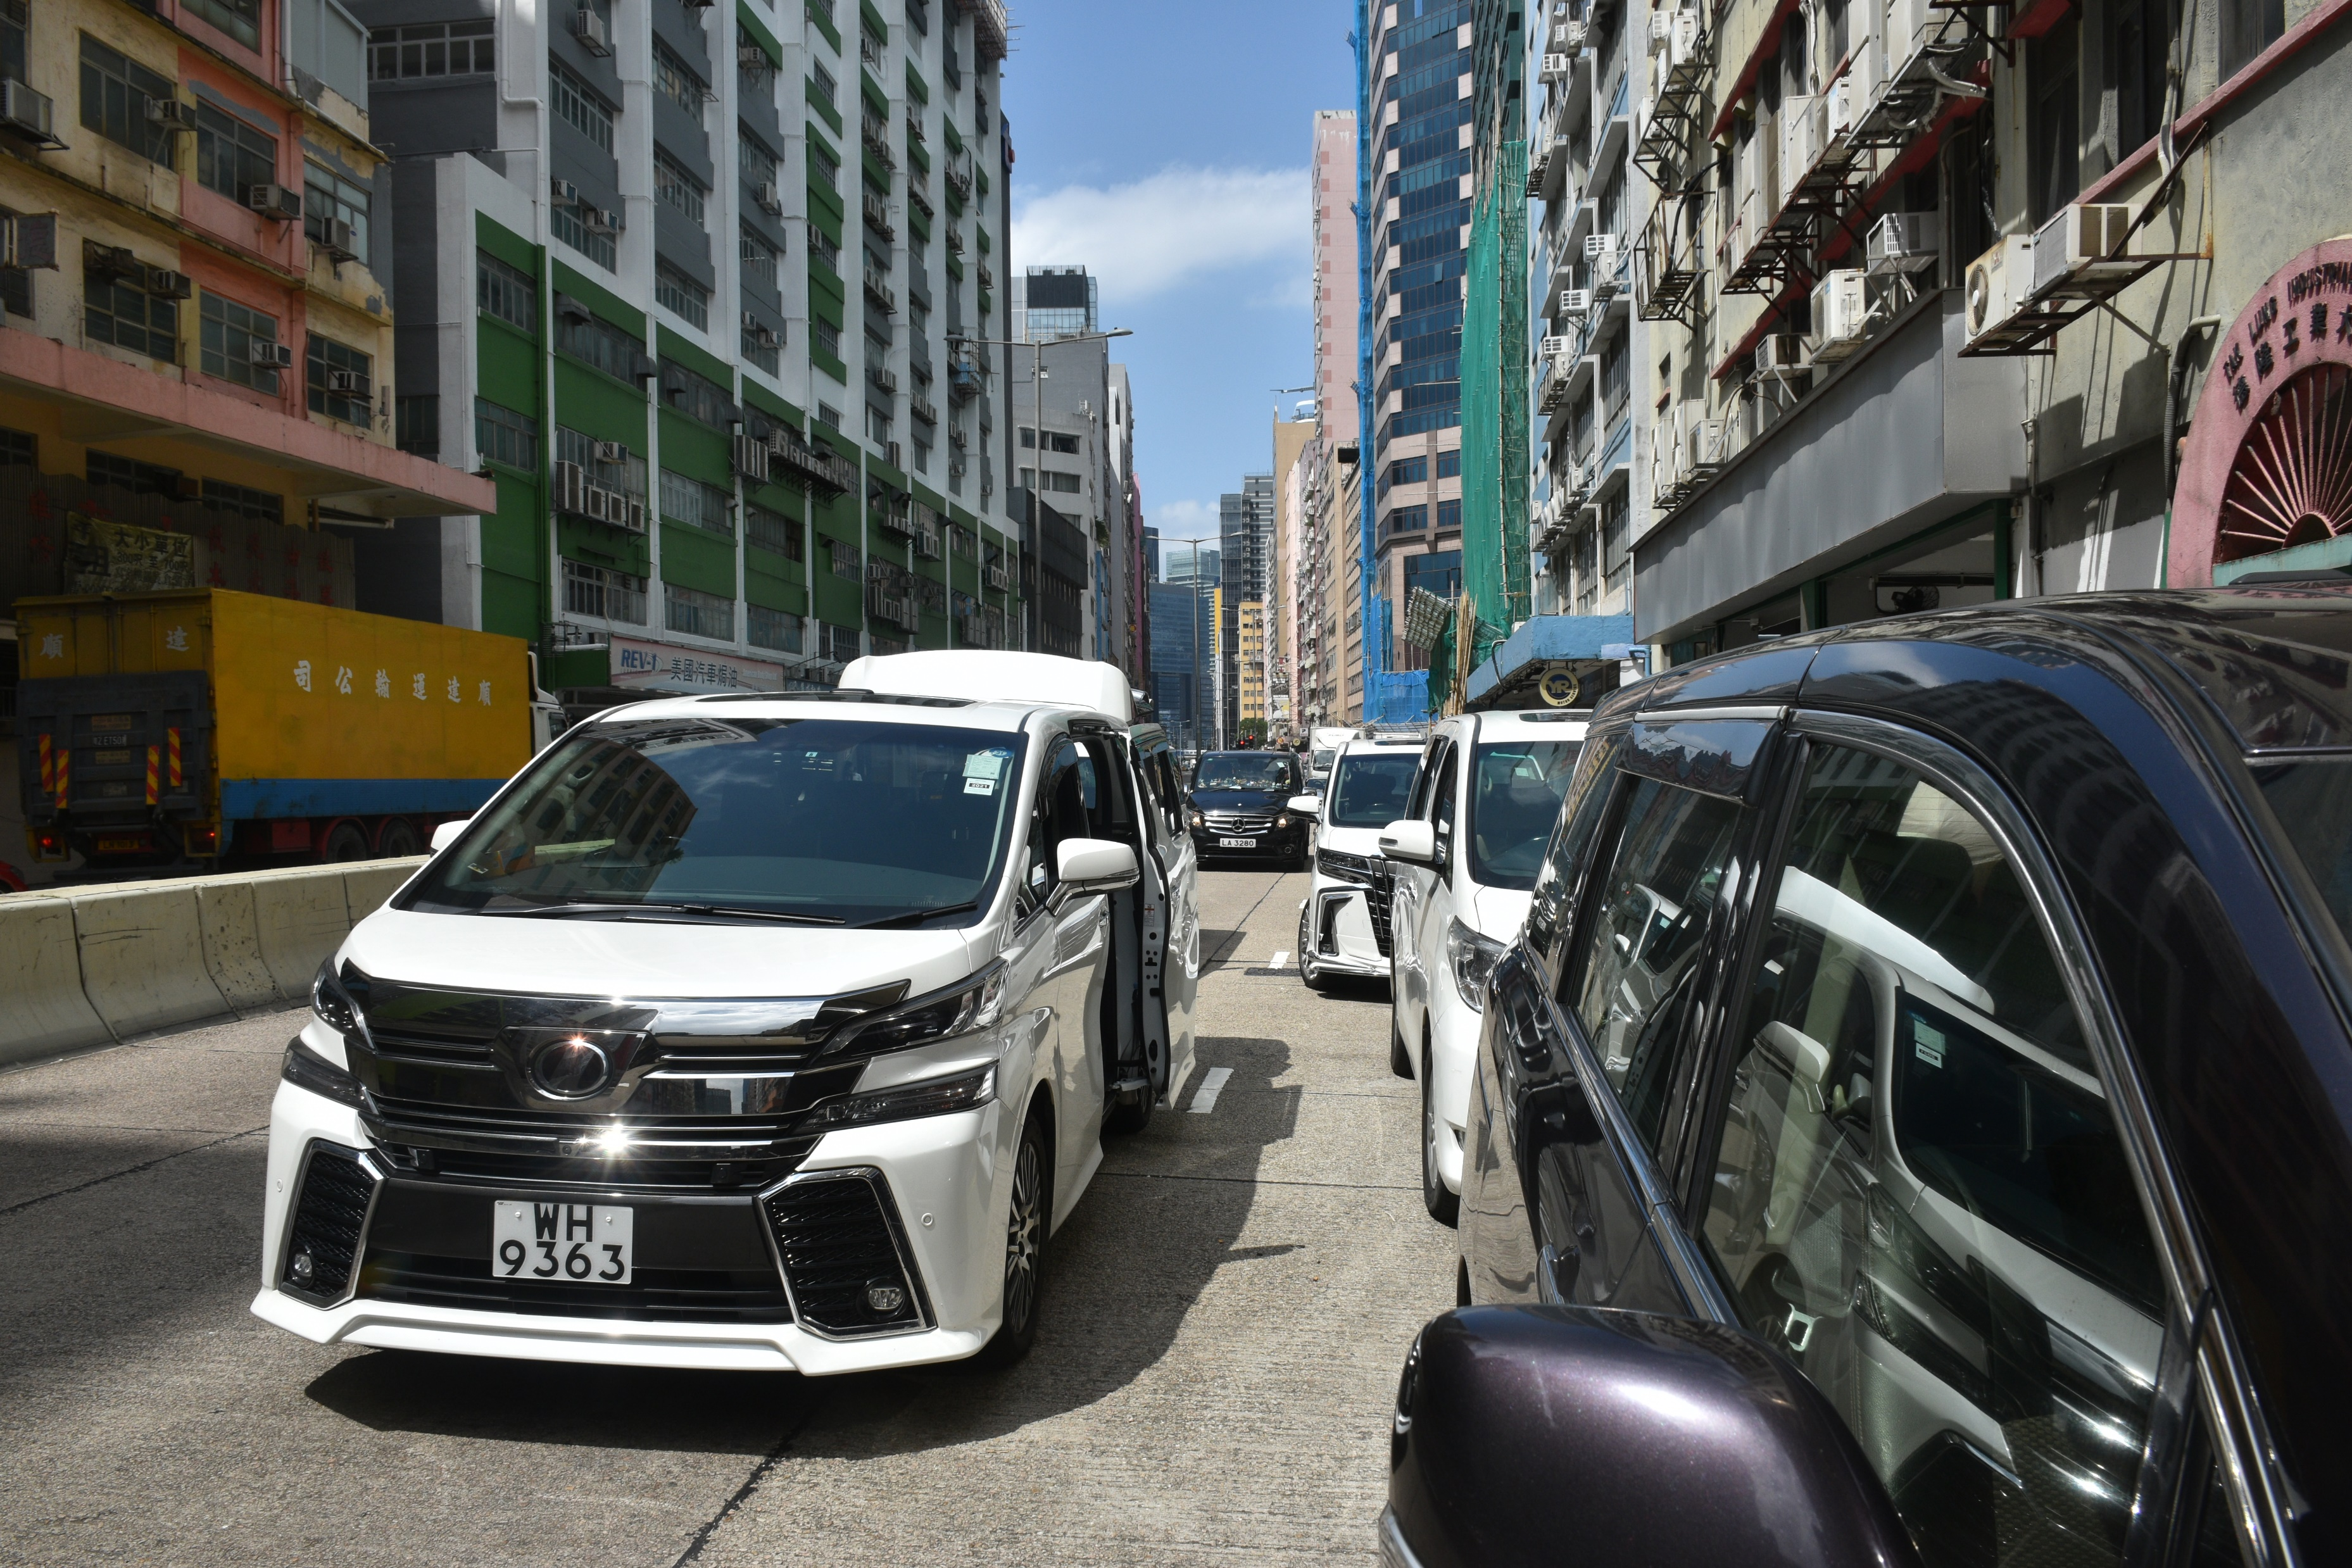
Location
Very high parking density
Double parking occurs

Slide 31
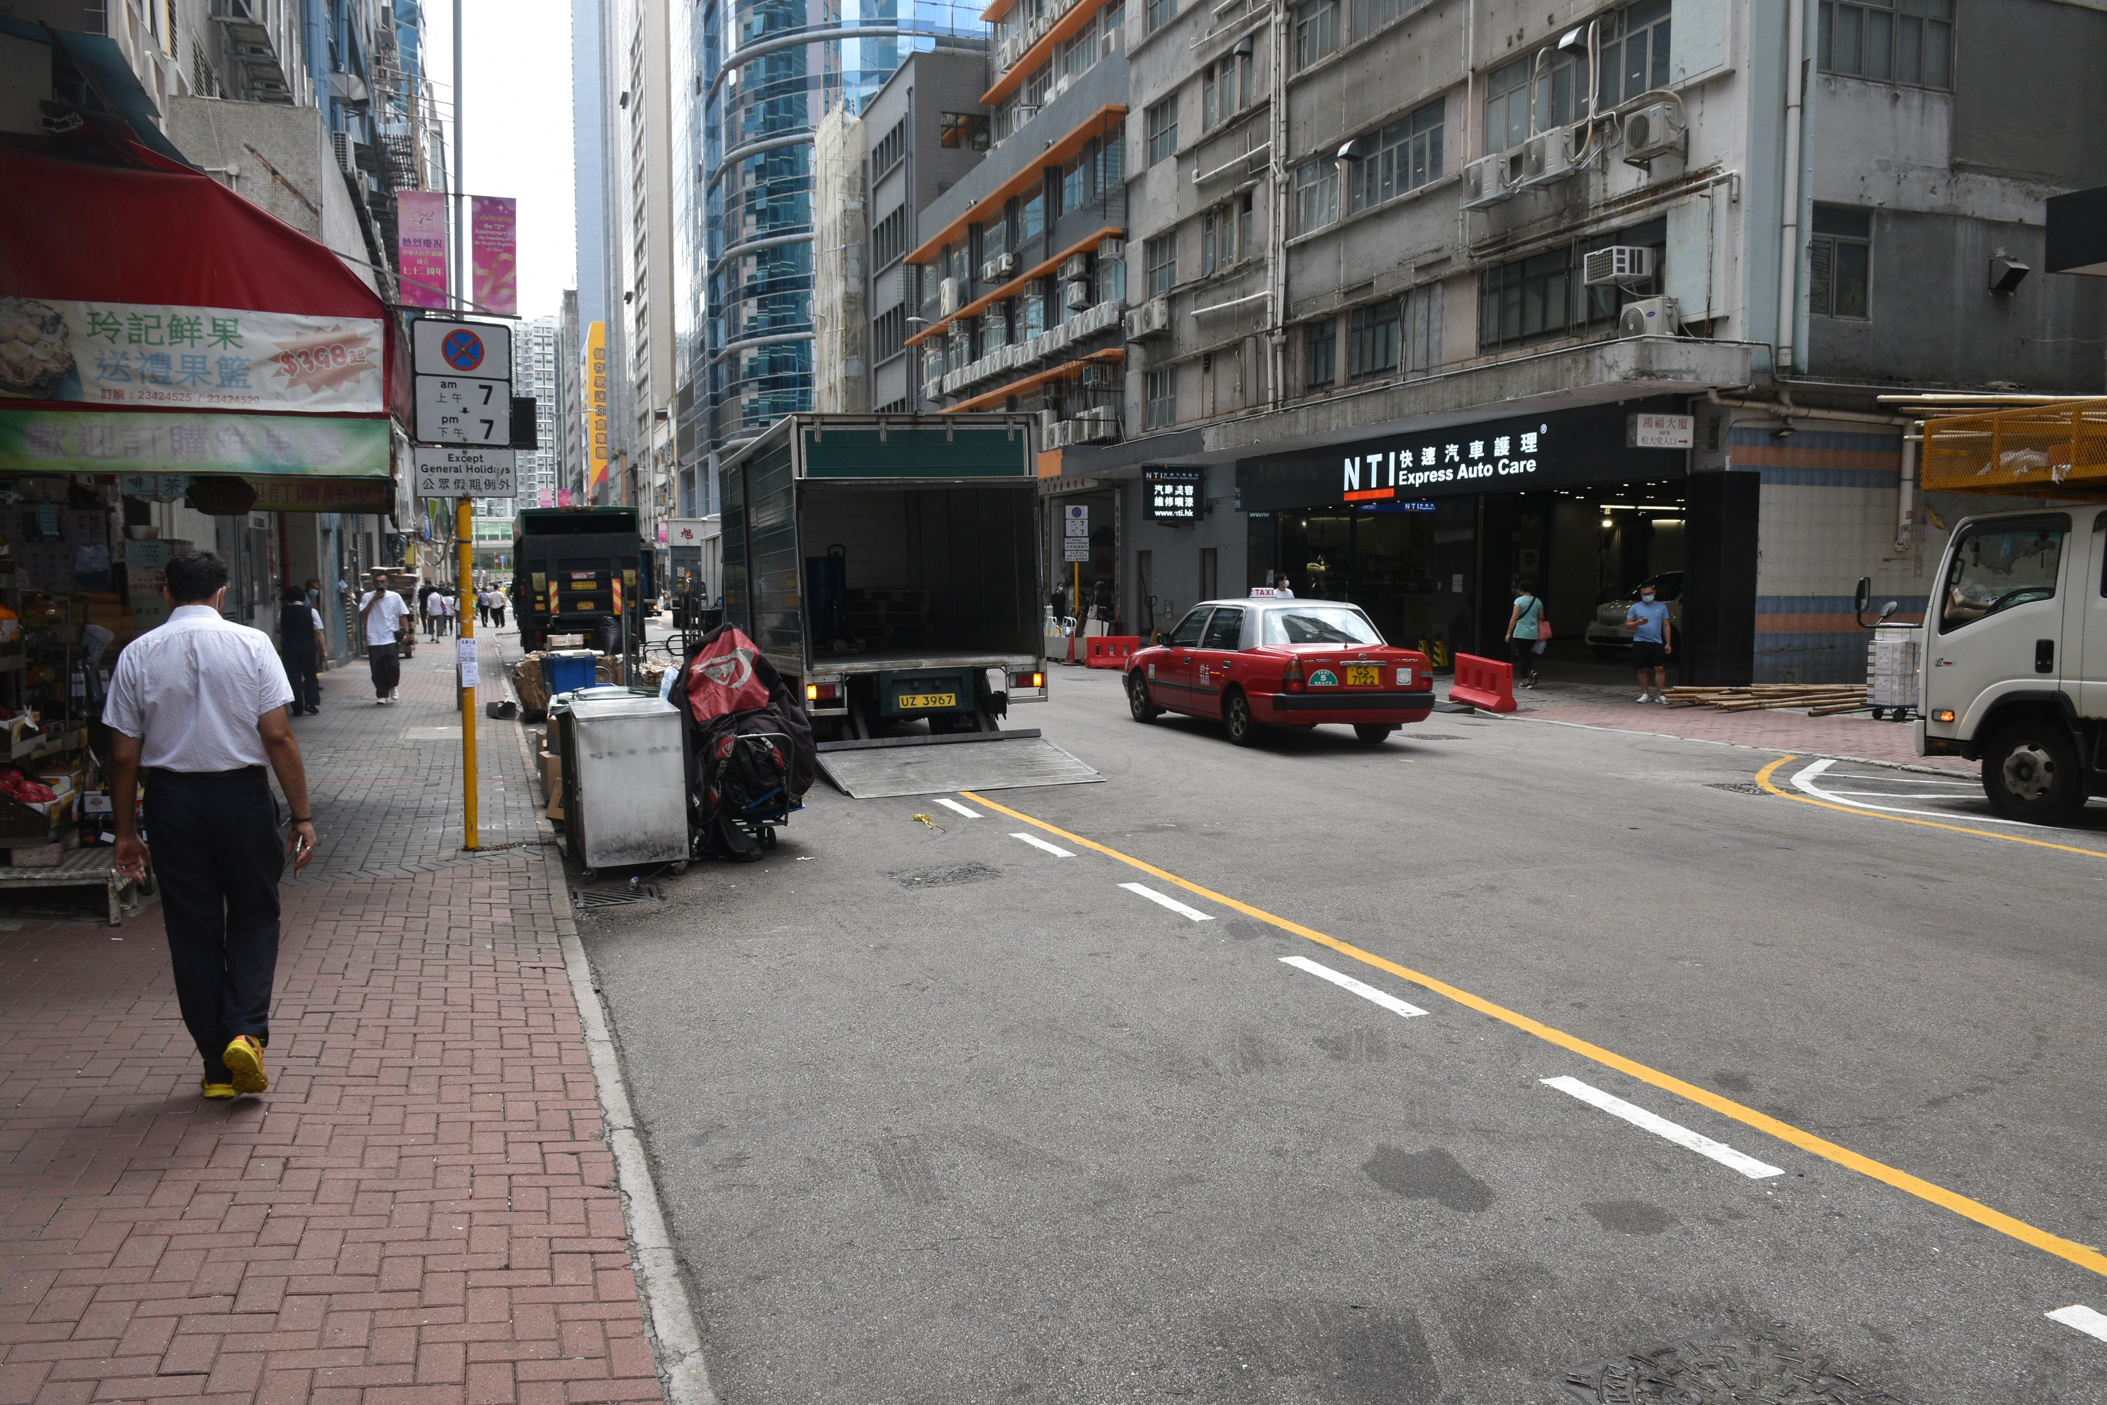
Driver forced to double park
Barricades obstructing parking space
Location
Notes:
DOUBLE PARKING

Slide 32
PEDESTRIAN INTERRUPTING TRAFFIC FLOW INCREASING da/dt

Slide 33
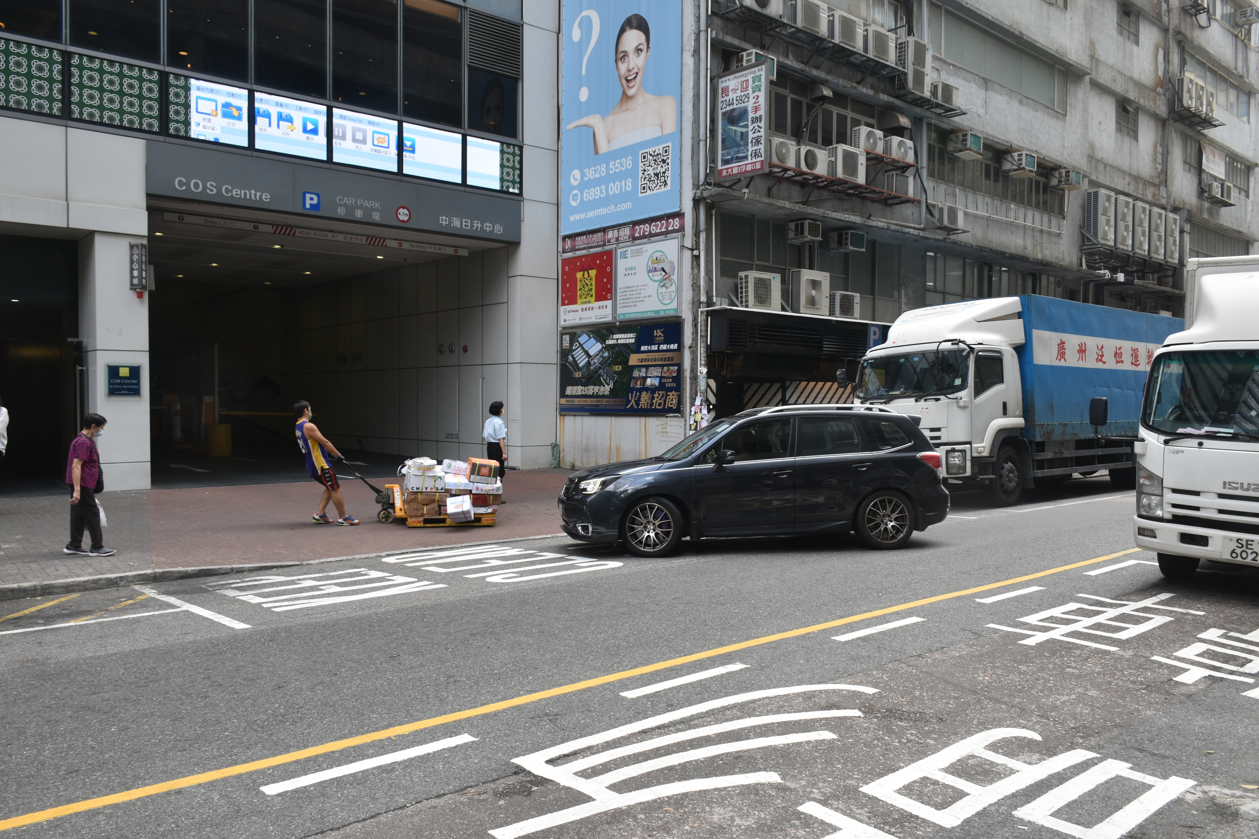
Increased wait times for traffic behind
Driver has to wait for pedestrians to clear the traffic
Blocking access to car park entrance
Pallet trucks are very bulky and slow to transport
Package on trailer falls onto ground
Location

Slide 34
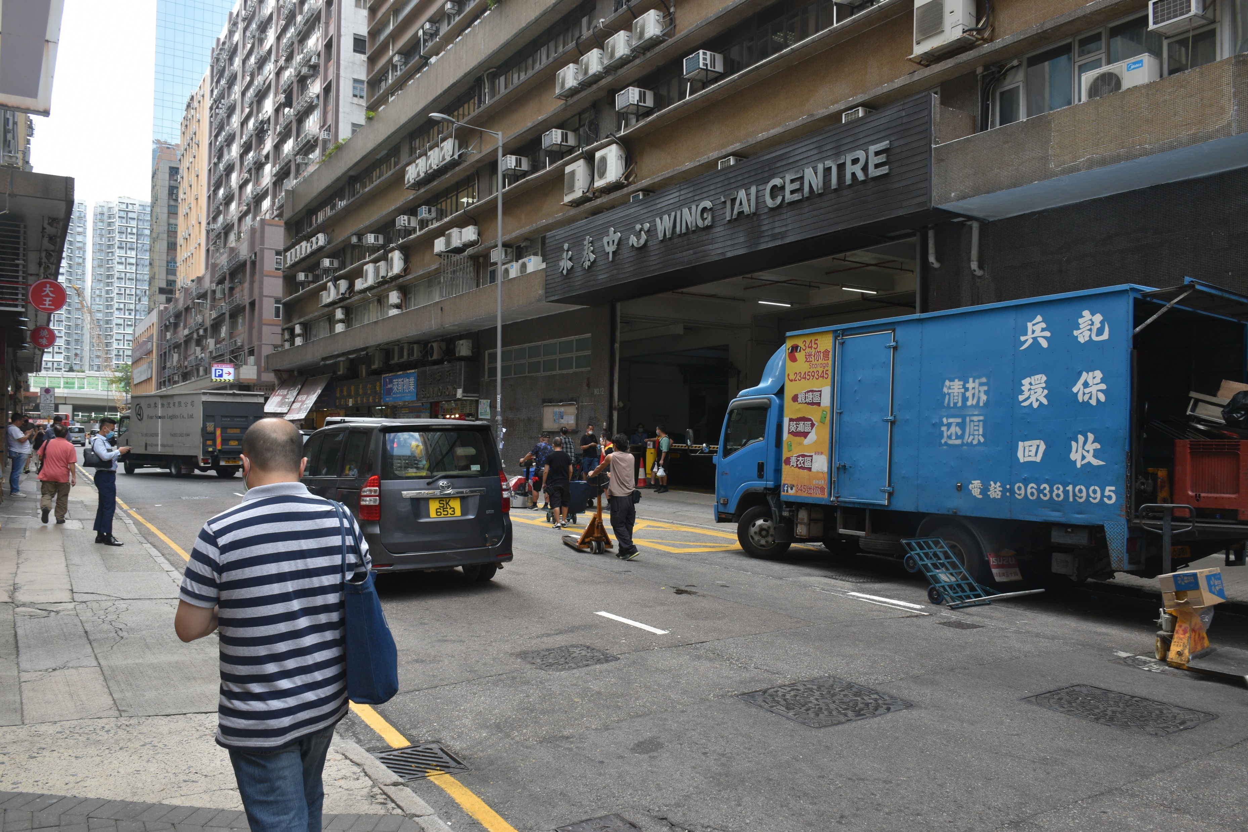
Group of people waiting for truck to arrive
Obstructs major entrance to industrial building
Increased awareness required for driver to avoid collisions with pedestrians
Areas with boxed yellow road markings should be kept clear
Location

Slide 35
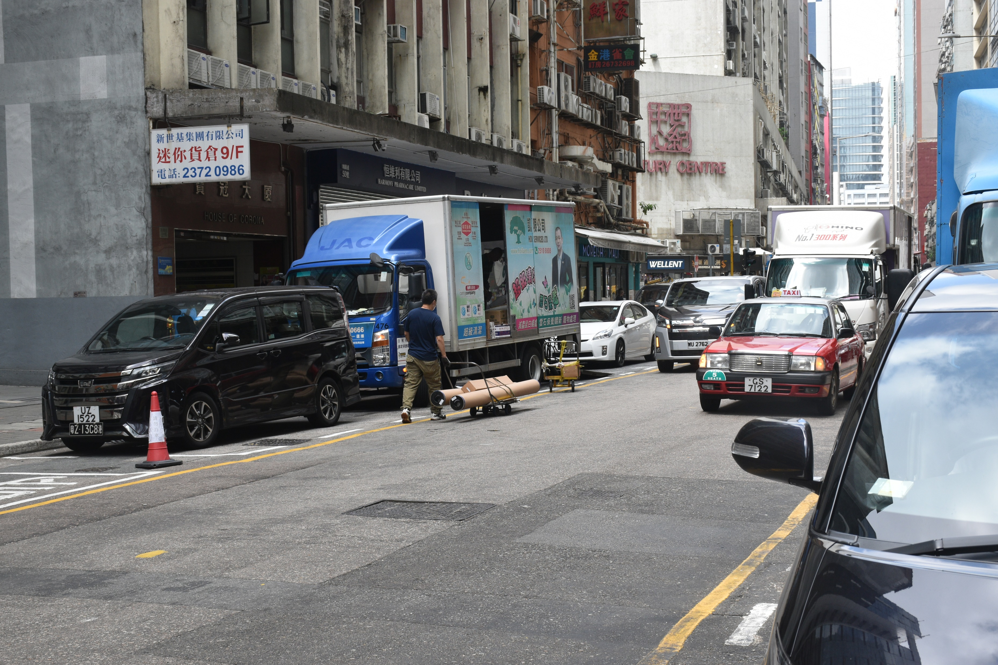
Should unload goods on kerbside
Unloading goods on the wrong side of road
Effective lanes reduced
Narrow passageway forces vehicles passing through to decrease speed
Location

Slide 36
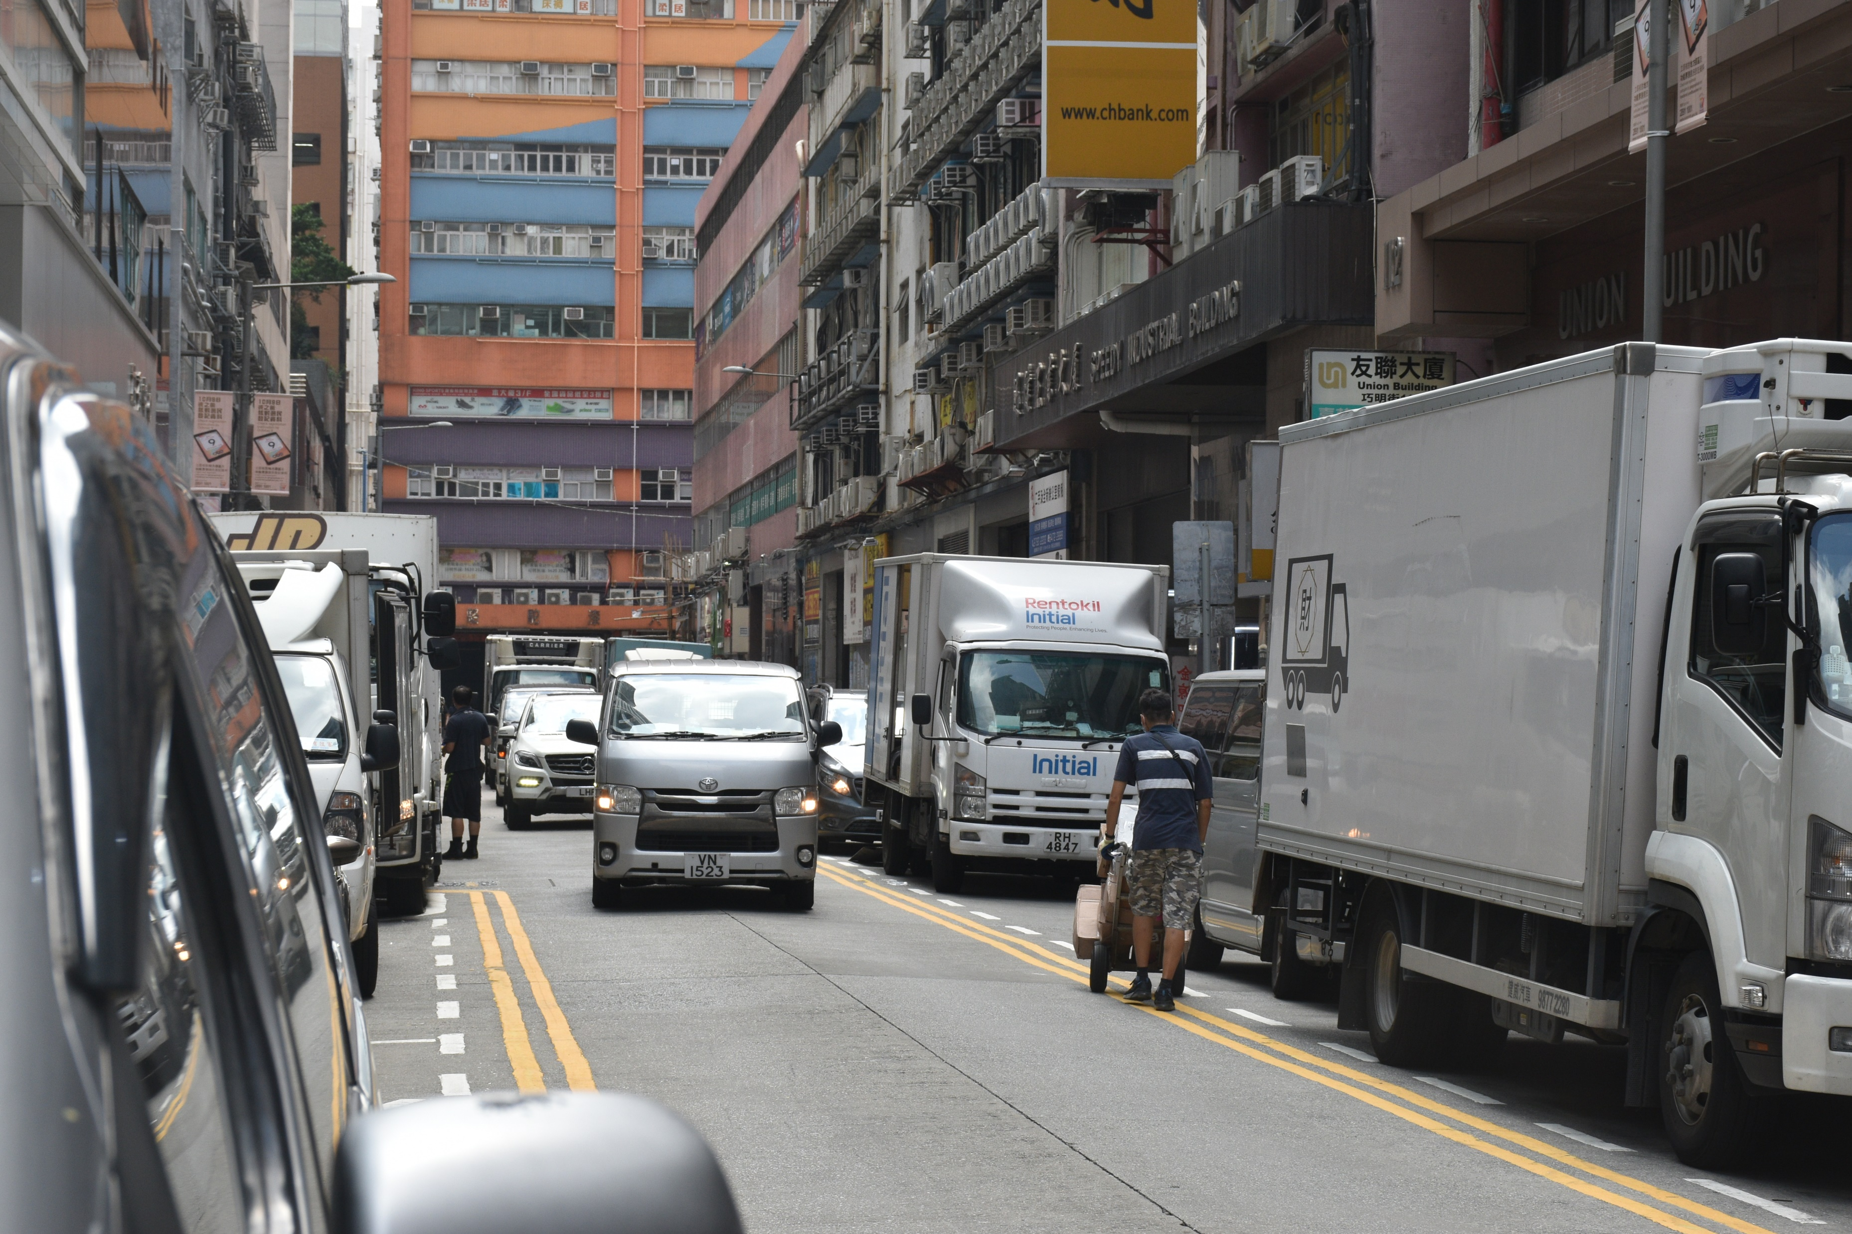
Mobile pedestrians create large “danger zones”
Manoeuvring required to avoid pedestrians
Location

Slide 37
POOR ROAD DESIGN
TSUN YIP STREET LANE DESIGN

Slide 38
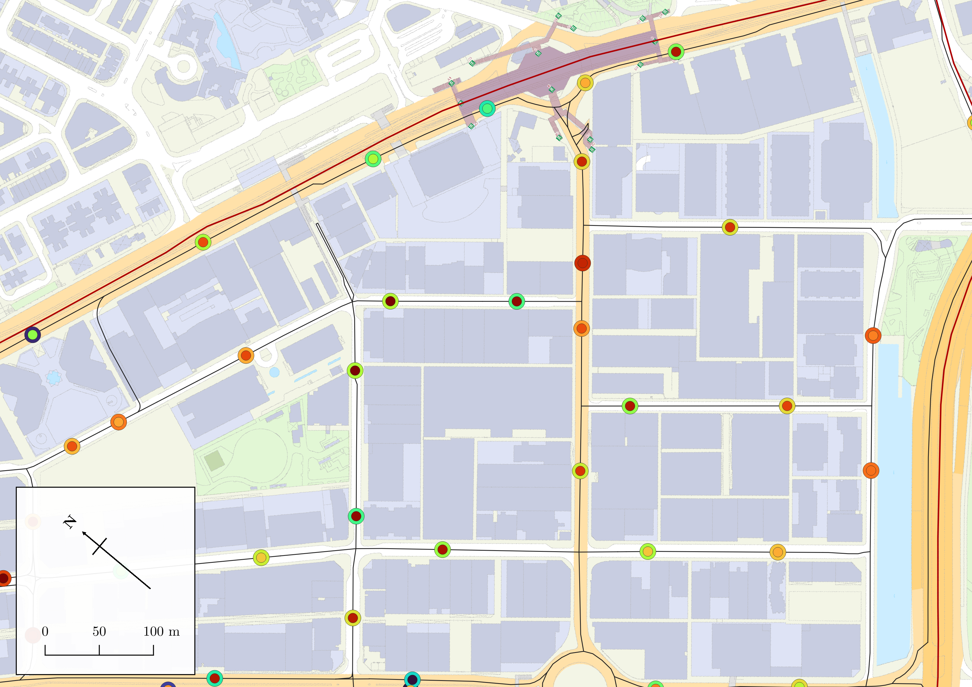
Legend
A
Study Area
Direction of traffic flow
KWUN TONG ROAD
Roads
*colour is indicative of traffic speed
Outer circle: parking accessibility
Inner circle: relative traffic speed
Colour denotes magnitude of variables
Parking accessibility
Relative traffic speed
B
Area 4
SHING YIP STREET
0
0.0736
270
10252
HOW MING STREET
Area 3
H
D
C
HOW MING STREET
KING YIP STREET
E
HOI YUEN ROAD
HING YIP STREET
TSUN YIP STREET
G
HUNG TO ROAD
F
WAI YIP STREET

Slide 39
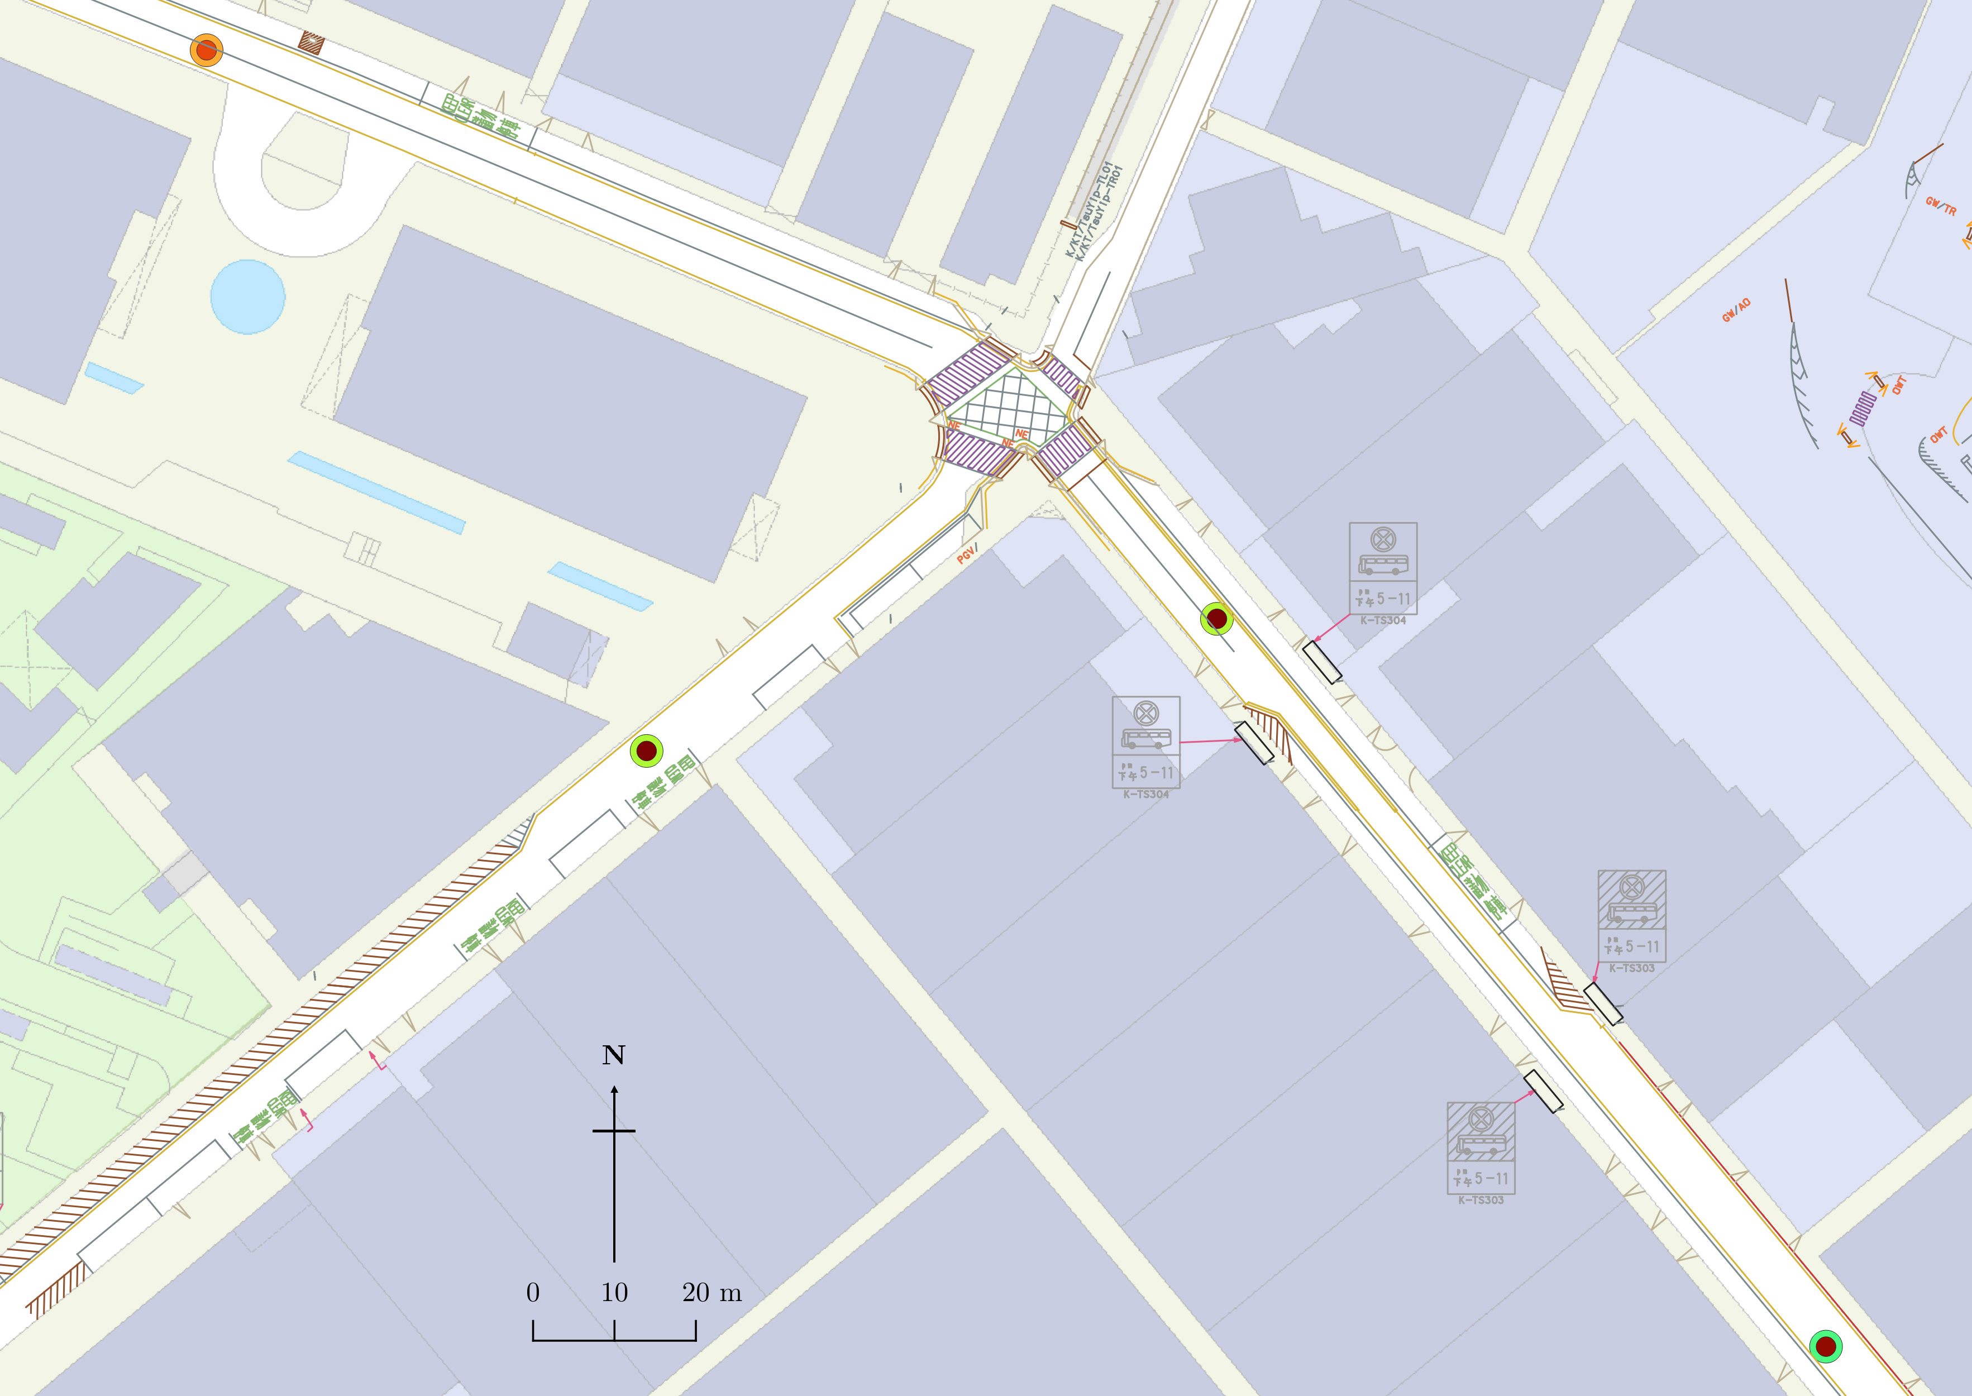
H
Legend
Traffic Lane Separator
Direction of traffic flow
HOW MING STREET
*colour is indicative of traffic speed
Outer circle: parking accessibility
Inner circle: relative traffic speed
Colour denotes magnitude of variables
Parking accessibility
Relative traffic speed
0
0.0736
270
10252
D
HOW MING STREET
TSUN YIP STREET
E

Slide 40
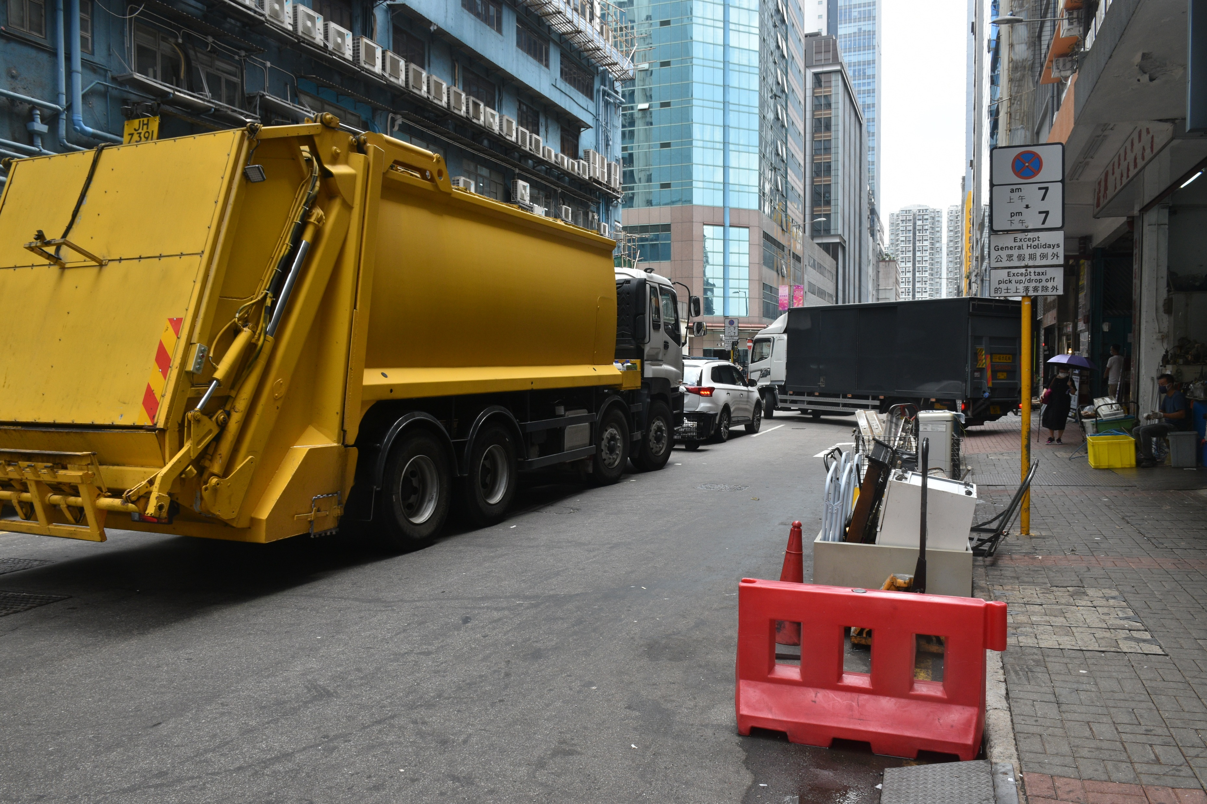
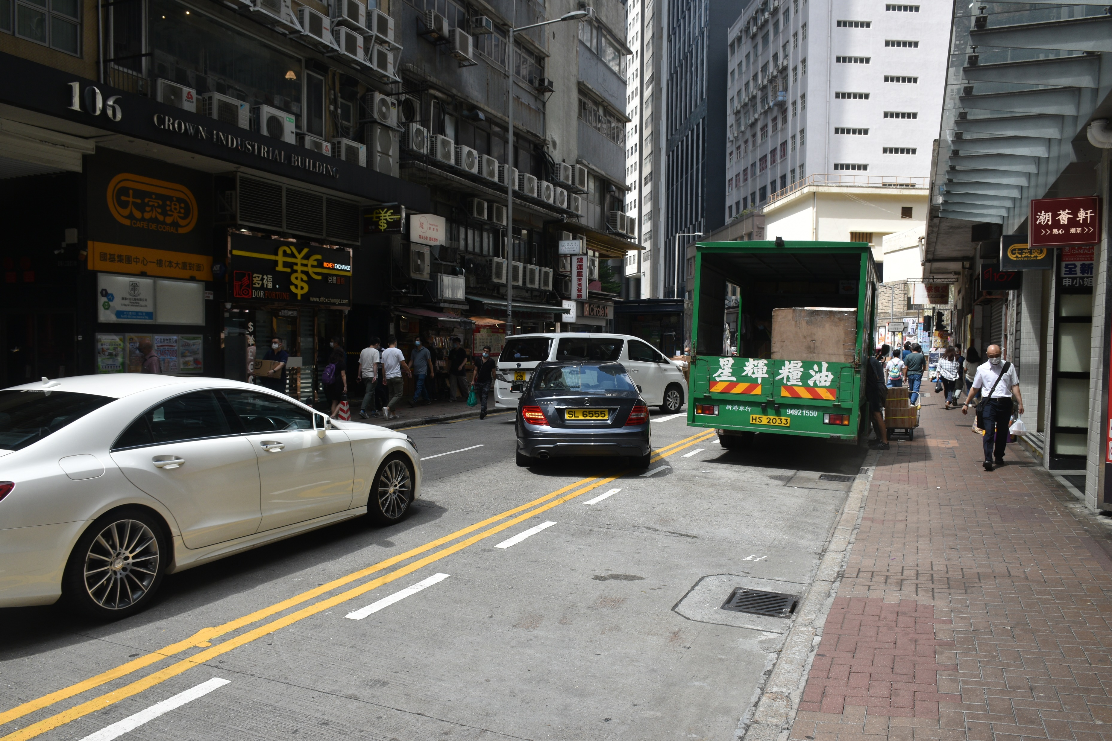
Notes:
POOR ROAD DESIGN??

Slide 41
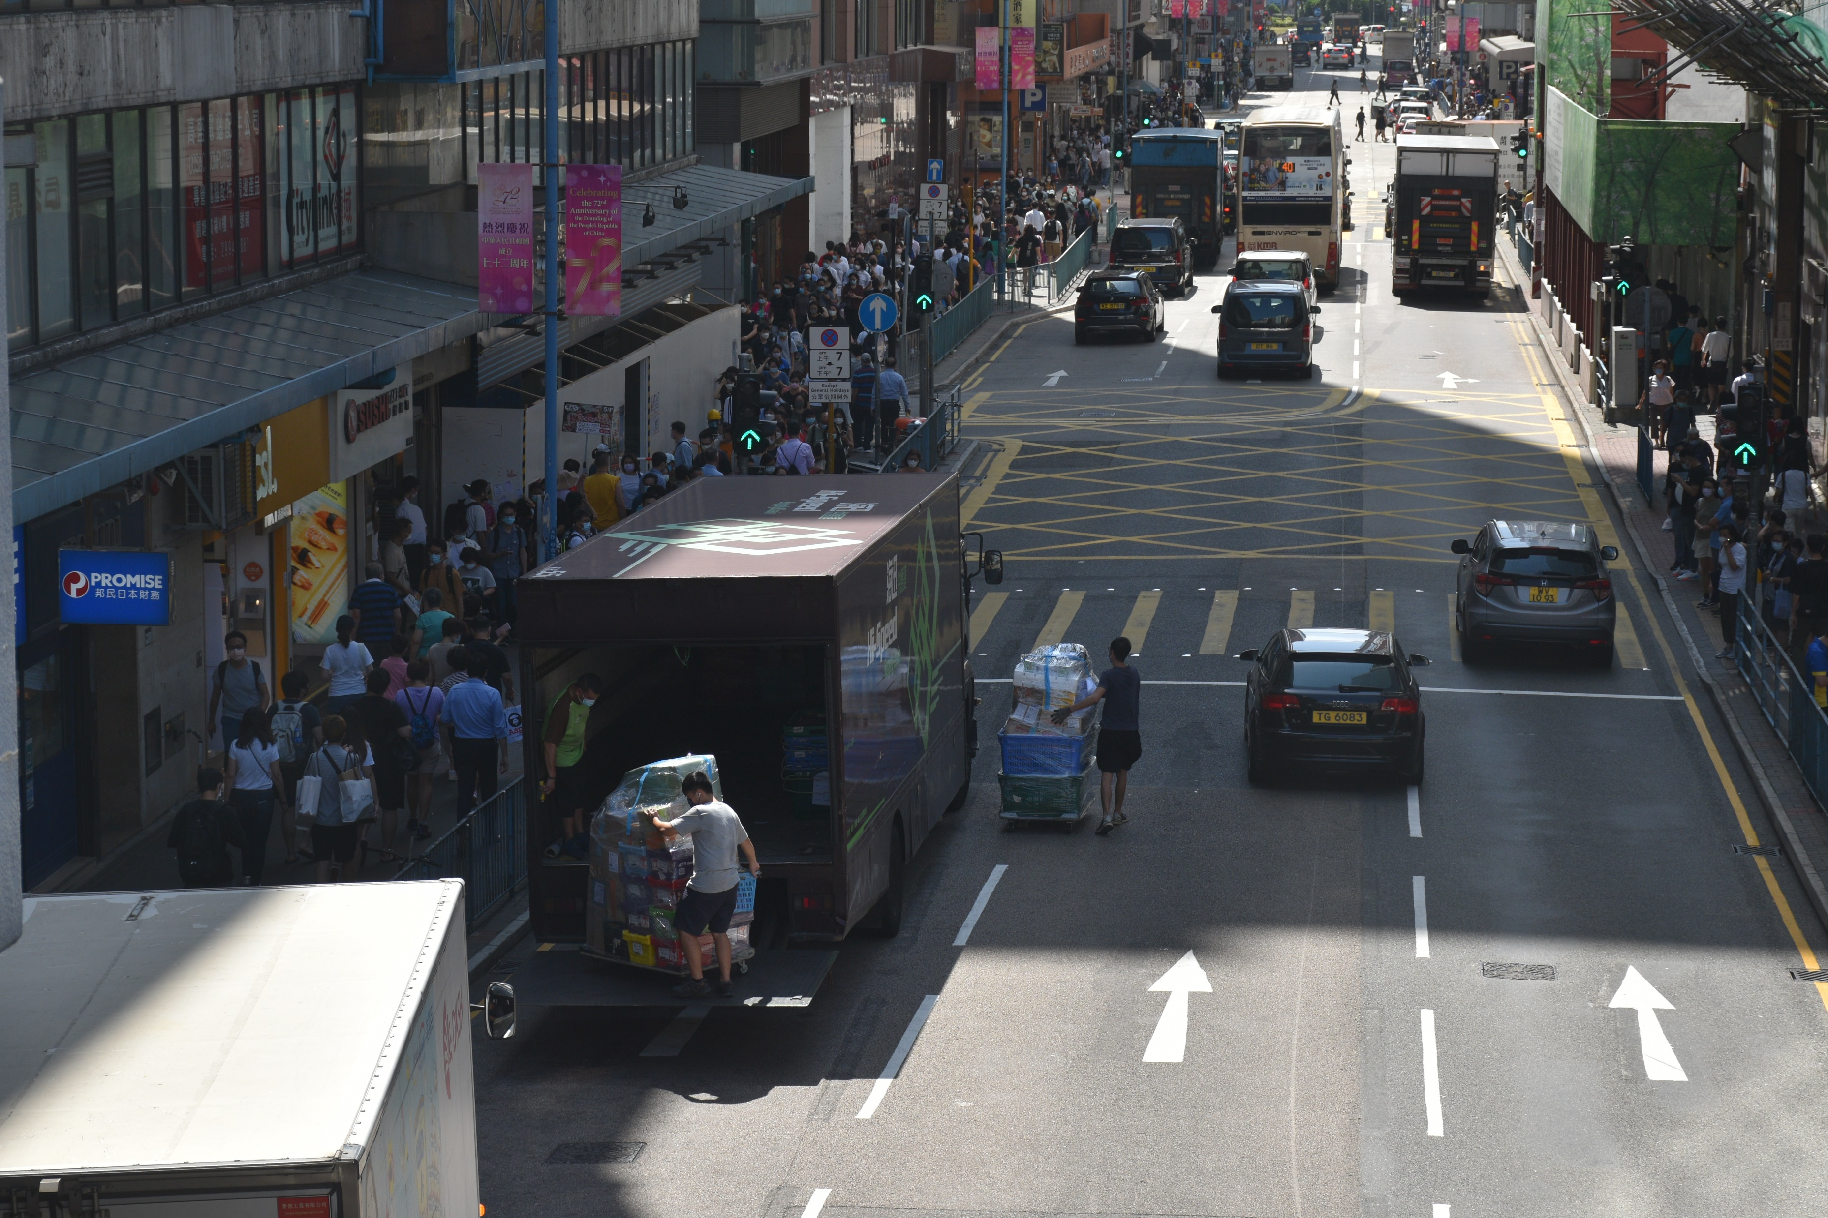
Illustrates how vehicles are willing to park at any spot

Slide 42
MISC

Slide 43
